Slide 1
Quant Methods for HSR I
Lecture 4: Getting Fancier with Regression
October 4, 2024
HAD5744 • Alex Hoagland, Ph.D.
Notes:
Mention: PS1; next week’s class will be about data cleaning and research designs (broadly), so please come with your research questions at least half-baked, so we can talk specifics. Project proposal ideas coming up in 3 weeks.
What do you do if you don’t have a question? Read through the data dictionaries here, then do some descriptive work! And also watch the video for next week, thinking about your questions!

Slide 2
Other Options with Regressions
There are multiple other things that can be done with a regression
Regression is a very flexible tool
In class, we’ll cover:
Options for variables (scaling & transformations)
Interactions
Nonlinear effects which are linear in parameters
Later, we’ll cover more nonlinear regression options:
Binary outcome variables (probit/logit)
General nonparametric approaches

Slide 3
Case Study: Children at Risk: The Effect of Crop Loss on Child Health in Rural Mexico
RUHR Economic Working Paper (2012)
Notes:
We’re going in and out of what’s actually in the paper, but we’re going to use it to frame all of the things we talk about today.

Slide 4
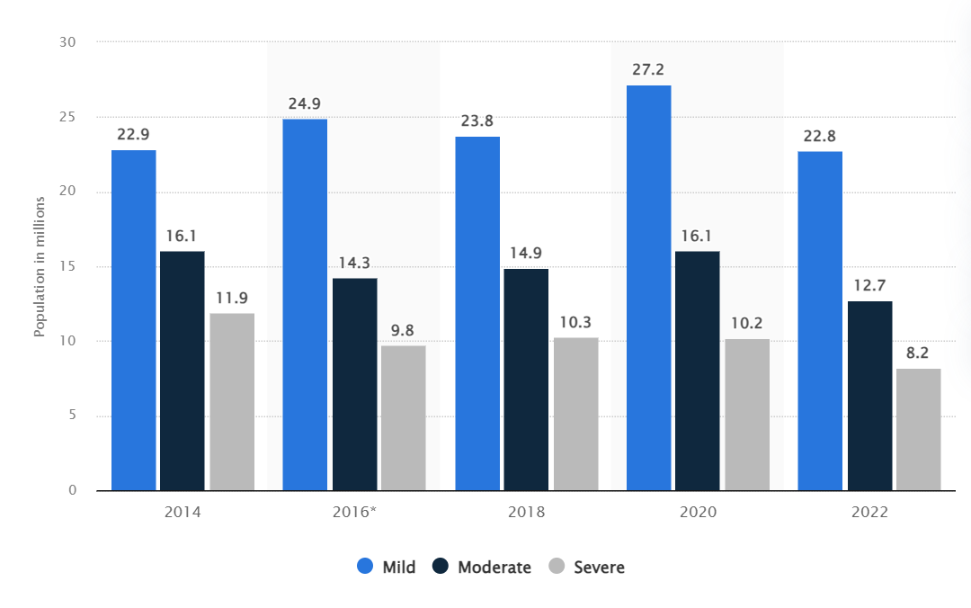
Motivation and Research Design
What is the setting of the paper?
What is the causal question?
Why is this an important question?
Notes:
We care a lot about malnutrition; this paper focuses particularly on its long-run effects.

Slide 5
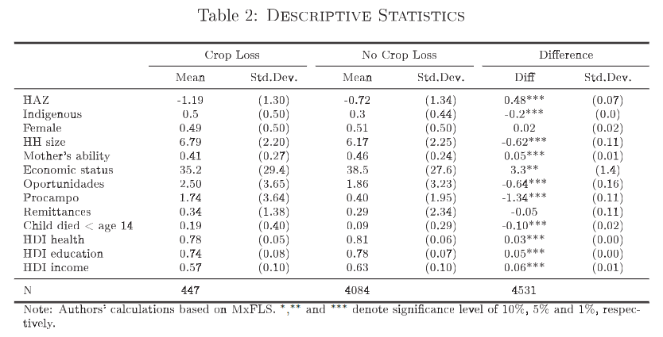
Motivation and Research Design
What makes their causal inference possible – that is, what is their research design?
How does it deal with this table?
Notes:
We’re going to talk a lot more about research designs in the coming lecture. For now, we are only using model-based inference, so they would have to control for a bunch. But they rely on the fact that crop loss is exogenous to children; what does that mean?

Slide 6
Variable Selection: Transformations

Slide 7
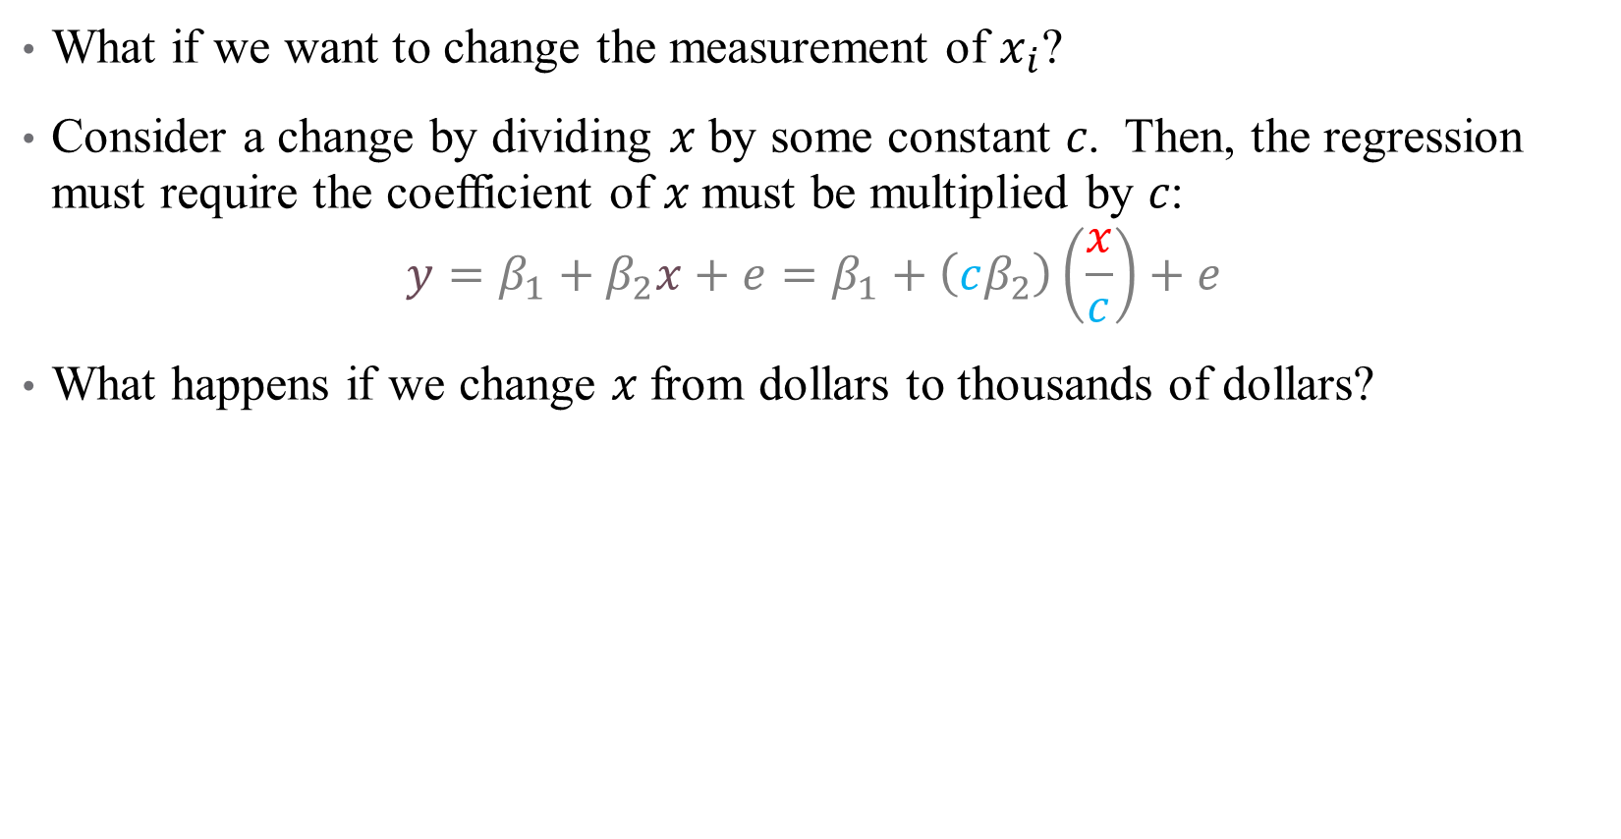
Scaling Regressors
What if we want to change the measurement of $x_{i}$?
Consider a change by dividing 𝑥 by some constant 𝑐. Then, the regression must require the coefficient of 𝑥 must be multiplied by 𝑐:
$$y=β_{1}+β_{2}x+e=β_{1}+\left(cβ_{2}\right)\left(\frac{x}{c}\right)+e$$
What happens if we change 𝑥 from dollars to thousands of dollars?
Notes:
This is directly related to the idea that if beta is the ME of 1, then the ME of 100 is 100*beta. May come in useful for your homework assignment – feel free to rescale variables as desired.

Slide 8
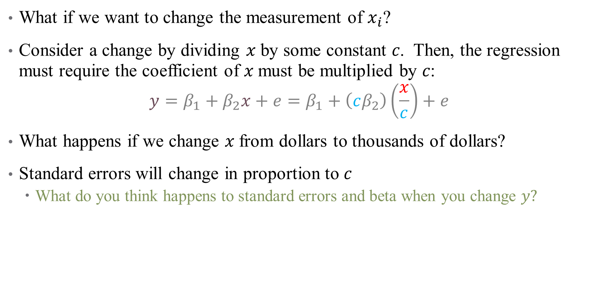
Scaling Regressors
What if we want to change the measurement of $x_{i}$?
Consider a change by dividing 𝑥 by some constant 𝑐. Then, the regression must require the coefficient of 𝑥 must be multiplied by 𝑐:
$$y=β_{1}+β_{2}x+e=β_{1}+\left(cβ_{2}\right)\left(\frac{x}{c}\right)+e$$
What happens if we change 𝑥 from dollars to thousands of dollars?
Standard errors will change in proportion to $c$
What do you think happens to standard errors and beta when you change $y?$
Notes:
They all change by the same amount

Slide 9
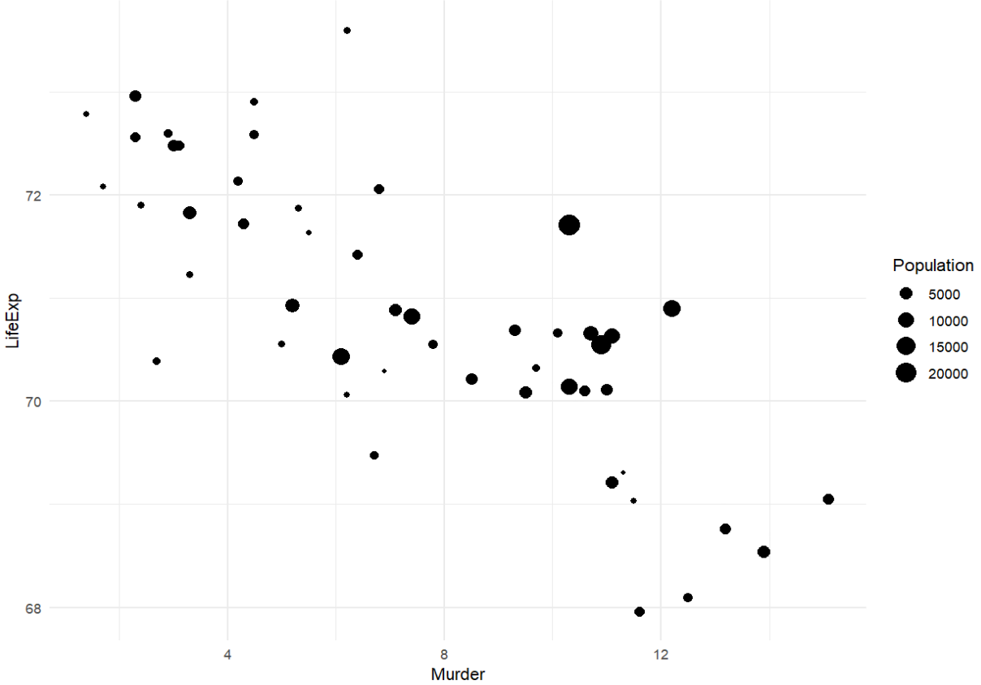
Scaling Observations
What if instead, we want to weight our observations differently?
Food insecurity
Notes:
Here, each point is a state; do we want all states to be counted equally in our regression?

Slide 10
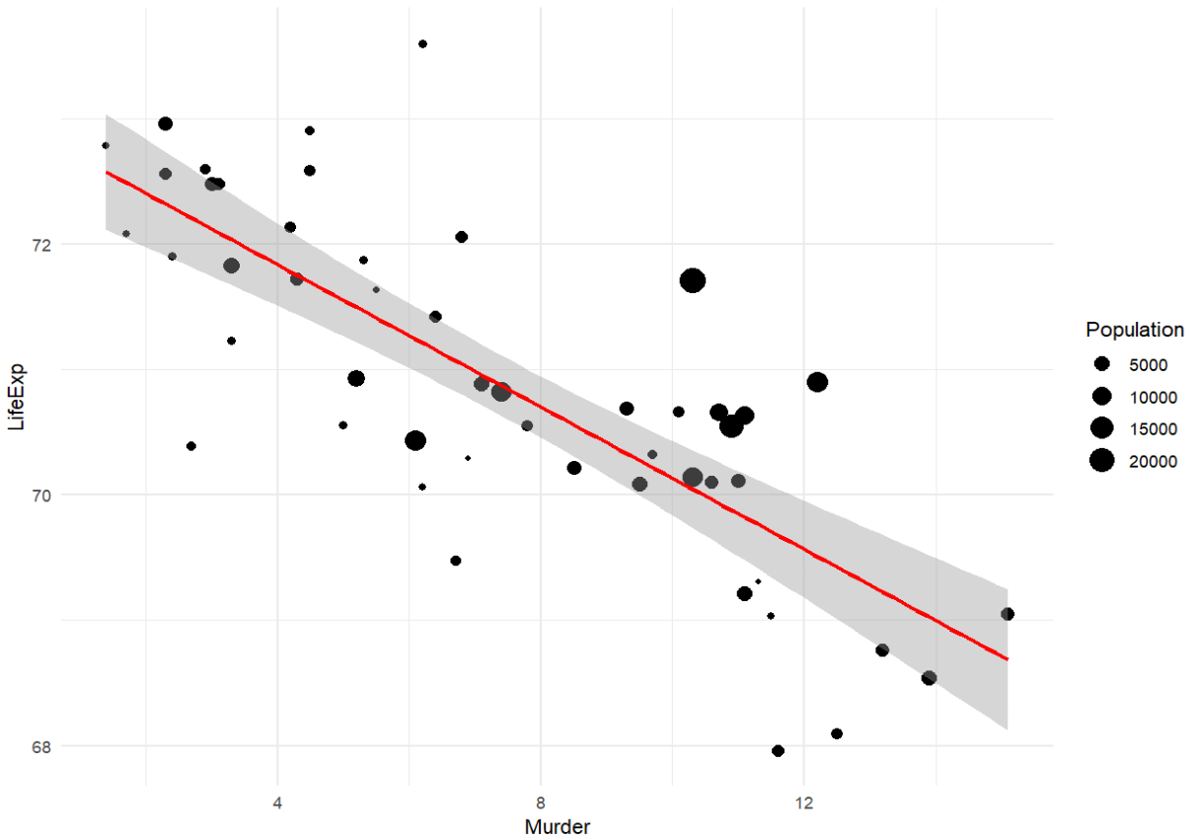
Scaling Observations
What if instead, we want to weight our observations differently?
Food insecurity
Notes:
This is without smoothing

Slide 11
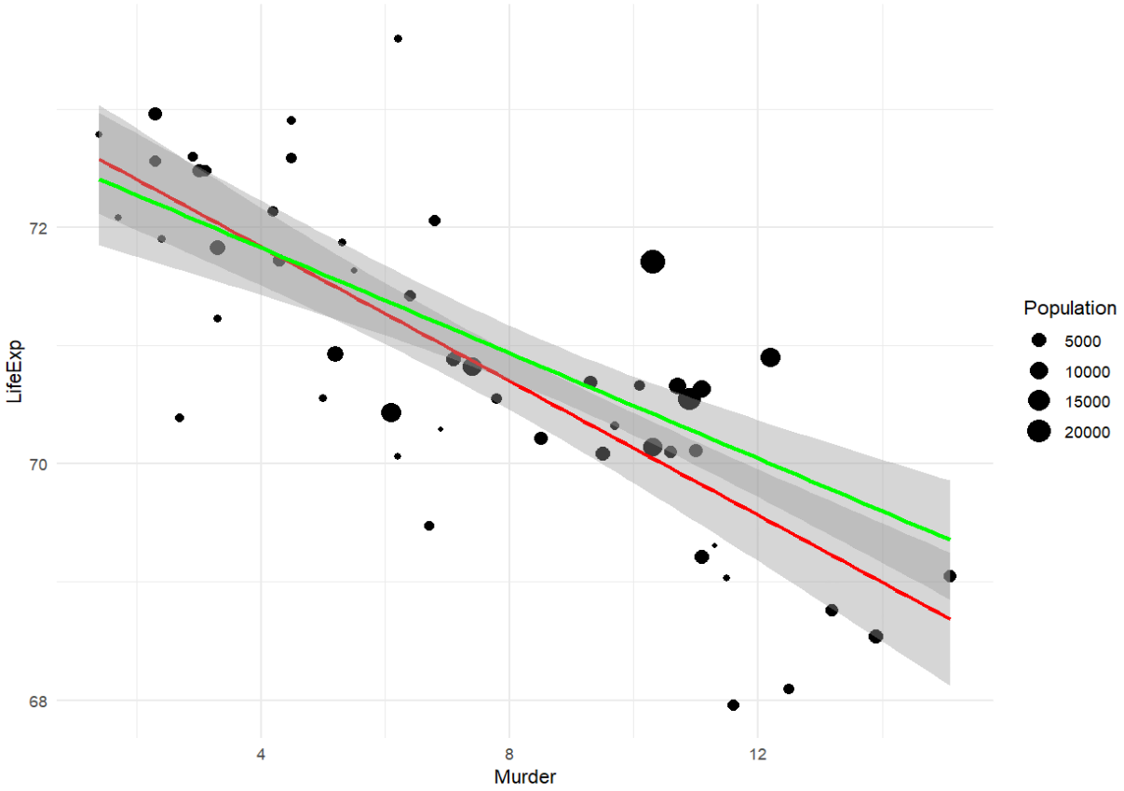

Scaling Observations
What if instead, we want to weight our observations differently?
Food insecurity
Notes:
What causes the differences here?

Slide 12
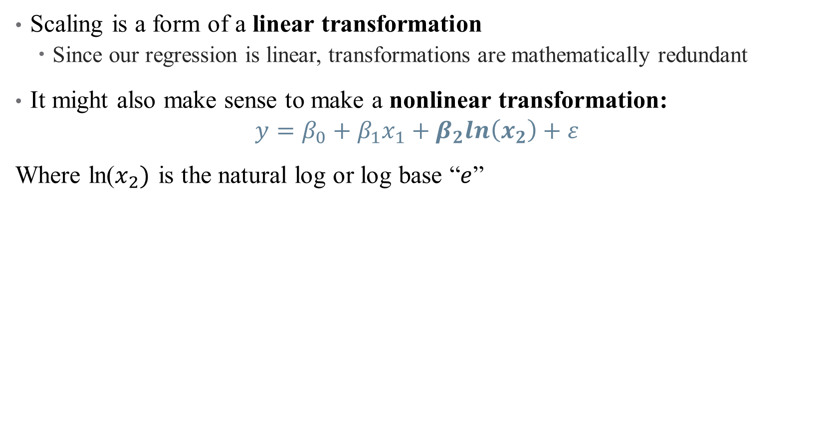
Nonlinear Transformations
Scaling is a form of a linear transformation
Since our regression is linear, transformations are mathematically redundant
It might also make sense to make a nonlinear transformation:
$$y=β_{0}+β_{1}x_{1}+β_{2}ln\left(x_{2}\right)+ε$$
Where ln($x_{2})$ is the natural log or log base “$e$”

Slide 13
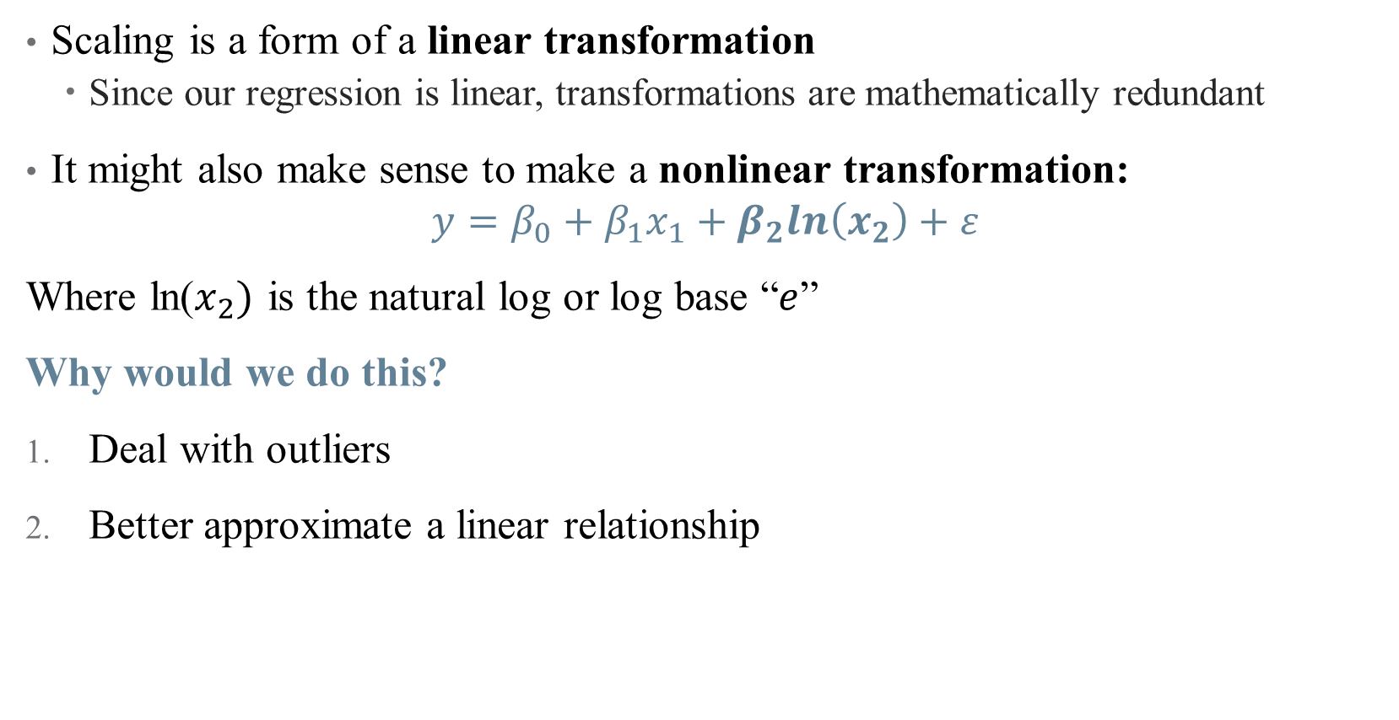
Nonlinear Transformations
Scaling is a form of a linear transformation
Since our regression is linear, transformations are mathematically redundant
It might also make sense to make a nonlinear transformation:
$$y=β_{0}+β_{1}x_{1}+β_{2}ln\left(x_{2}\right)+ε$$
Where ln($x_{2})$ is the natural log or log base “$e$”
Why would we do this?
Deal with outliers
Better approximate a linear relationship

Slide 14
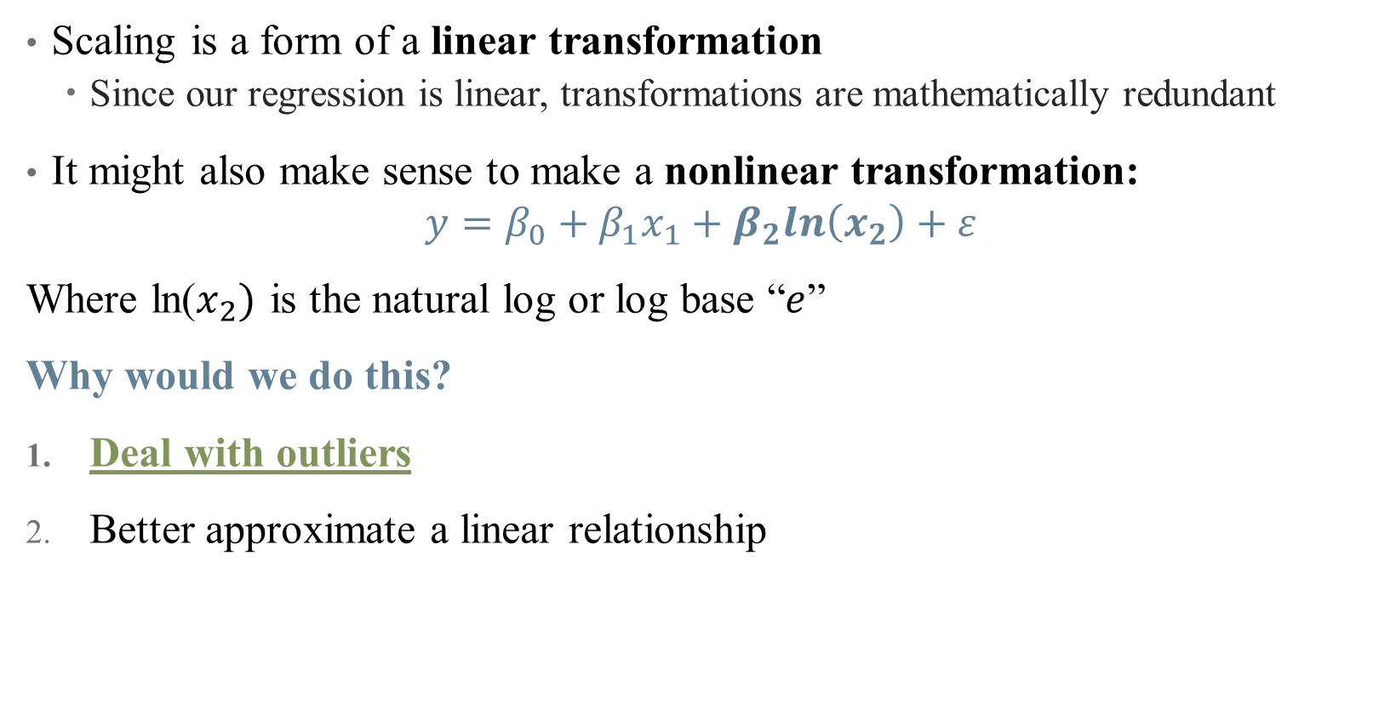
Nonlinear Transformations
Scaling is a form of a linear transformation
Since our regression is linear, transformations are mathematically redundant
It might also make sense to make a nonlinear transformation:
$$y=β_{0}+β_{1}x_{1}+β_{2}ln\left(x_{2}\right)+ε$$
Where ln($x_{2})$ is the natural log or log base “$e$”
Why would we do this?
Deal with outliers
Better approximate a linear relationship

Slide 15
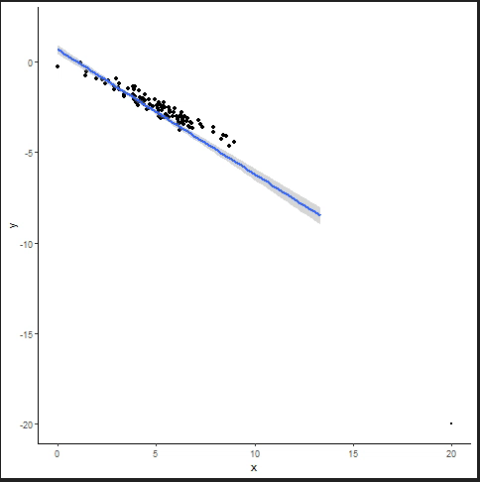
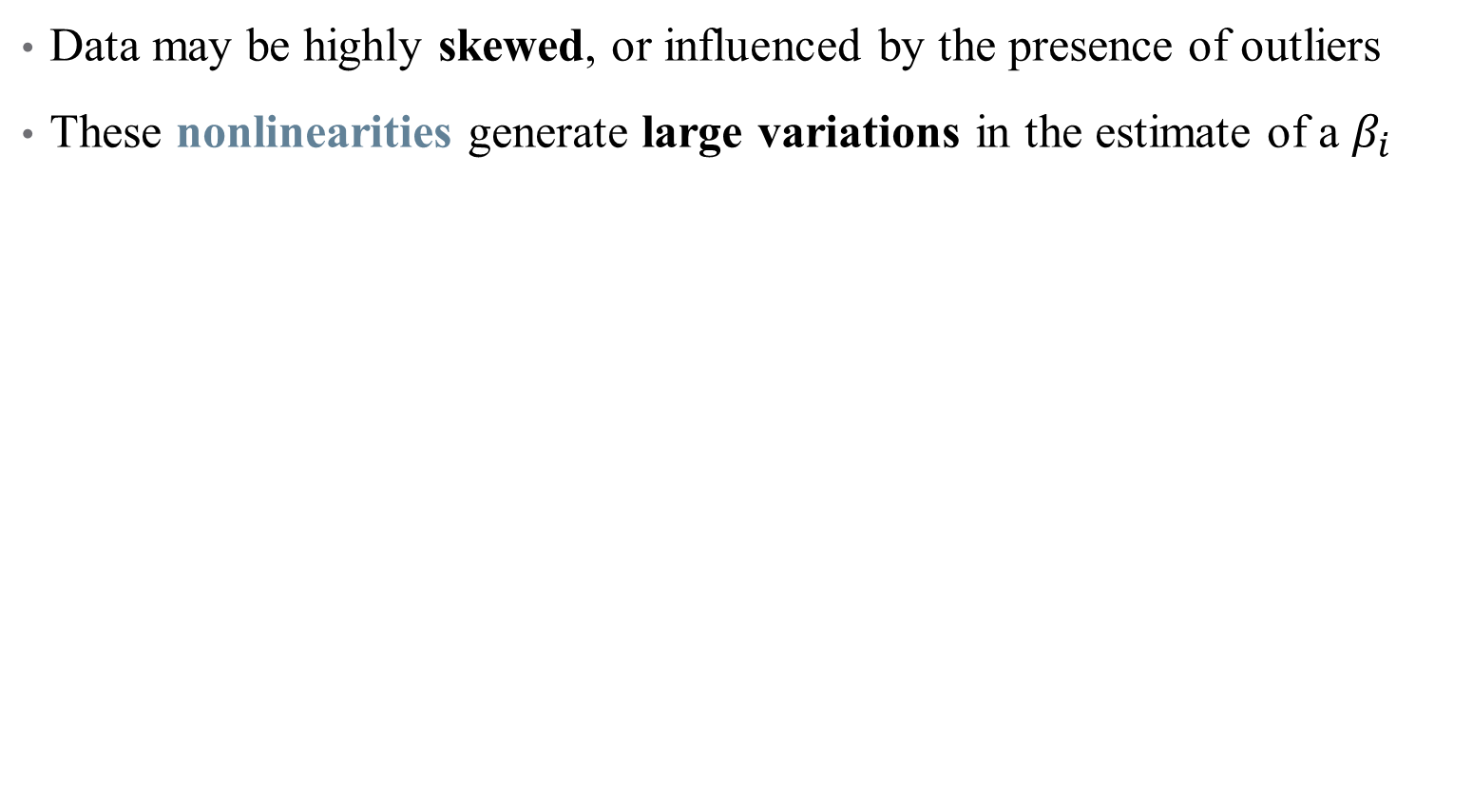
Nonlinear Transformations: Outliers
Data may be highly skewed, or influenced by the presence of outliers
These nonlinearities generate large variations in the estimate of a $β_{i}$
Notes:
Example: income distribution

Slide 16
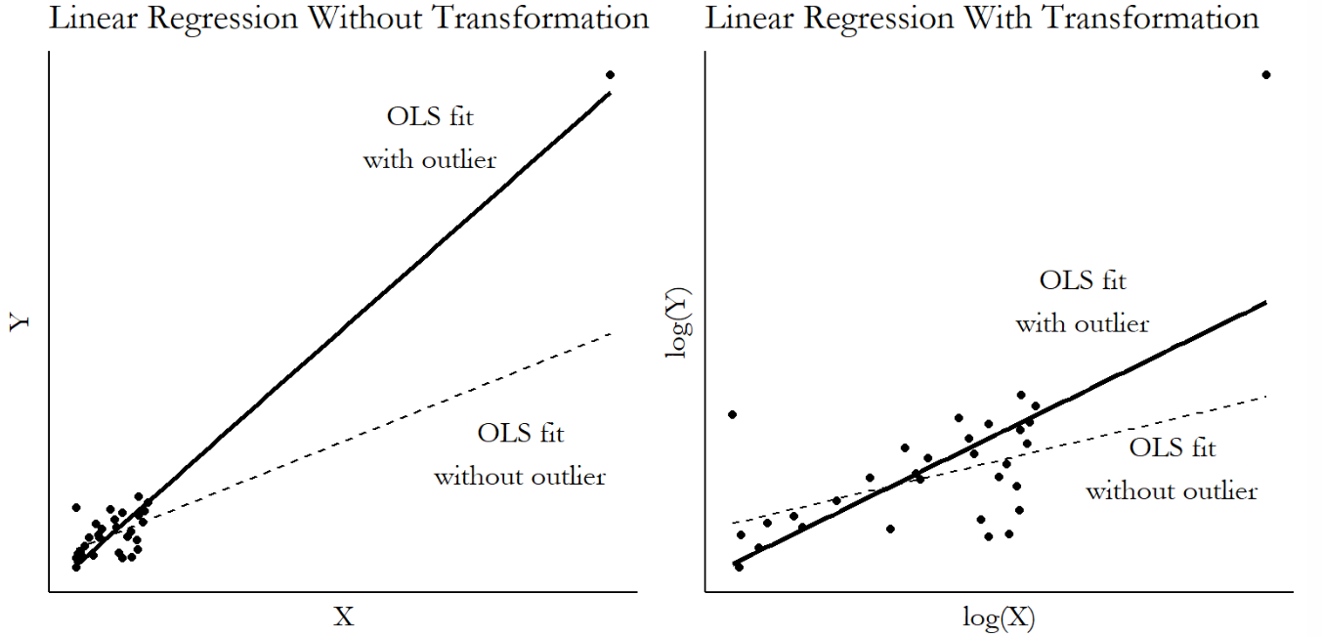
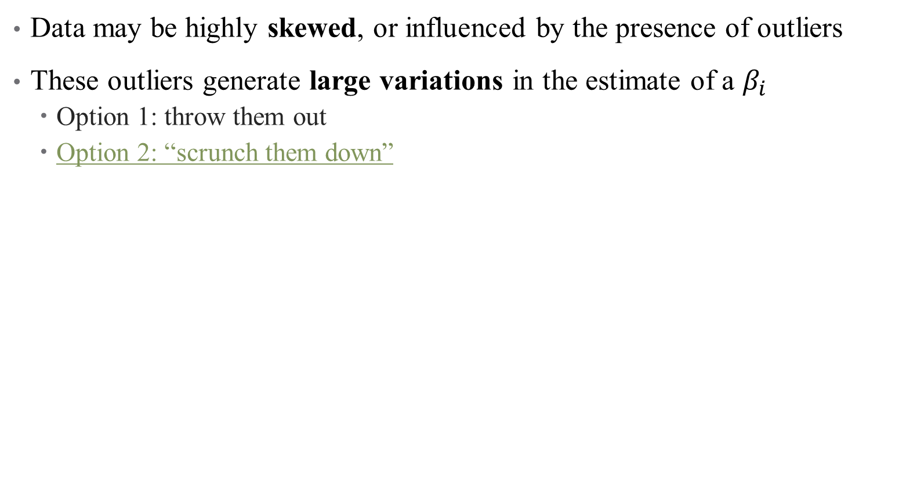
Nonlinear Transformations: Outliers
Data may be highly skewed, or influenced by the presence of outliers
These outliers generate large variations in the estimate of a $β_{i}$
Option 1: throw them out
Option 2: “scrunch them down”
Notes:
What does it mean to get selective with your data? That’s a bold move.

Slide 17
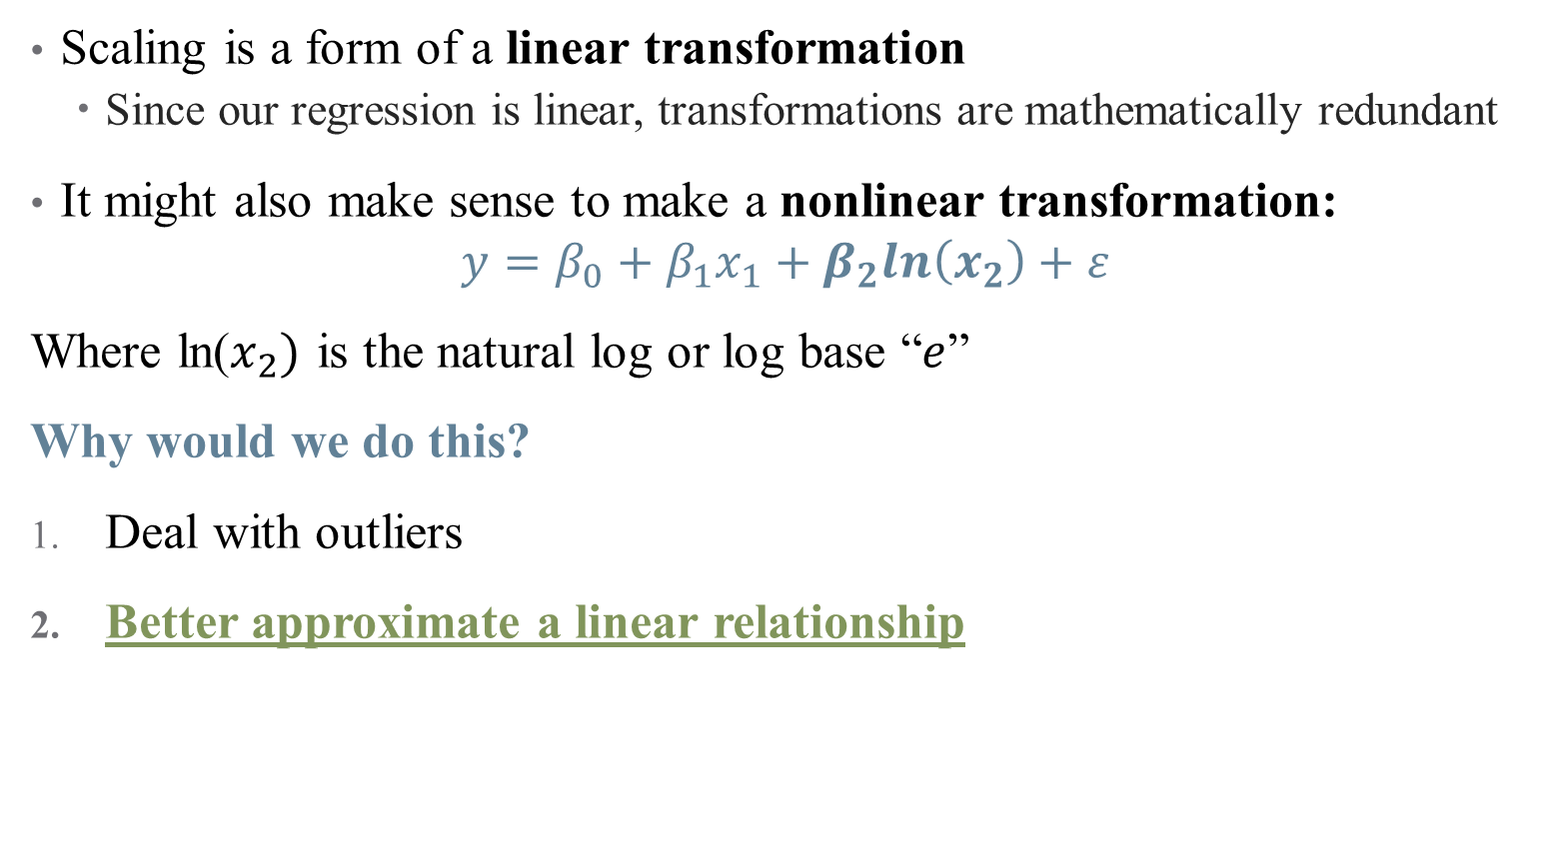
Nonlinear Transformations
Scaling is a form of a linear transformation
Since our regression is linear, transformations are mathematically redundant
It might also make sense to make a nonlinear transformation:
$$y=β_{0}+β_{1}x_{1}+β_{2}ln\left(x_{2}\right)+ε$$
Where ln($x_{2})$ is the natural log or log base “$e$”
Why would we do this?
Deal with outliers
Better approximate a linear relationship
Notes:
This is all about interpretation – what does it mean to interpret a single marginal effect if the distribution is wonky? Change from 10000 to 20000 annually versus change from 200000 to 210000

Slide 18
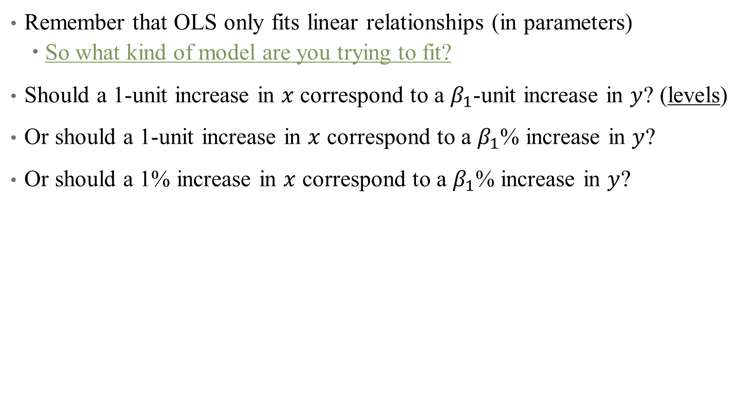
Nonlinear Transformations: Achieving “Linearity” (?)
Remember that OLS only fits linear relationships (in parameters)
So what kind of model are you trying to fit?
Should a 1-unit increase in $x$ correspond to a $β_{1}$-unit increase in $y$? (levels)
Or should a 1-unit increase in $x$ correspond to a $β_{1}$% increase in $y$?
Or should a 1% increase in $x$ correspond to a $β_{1}$% increase in $y$?

Slide 19
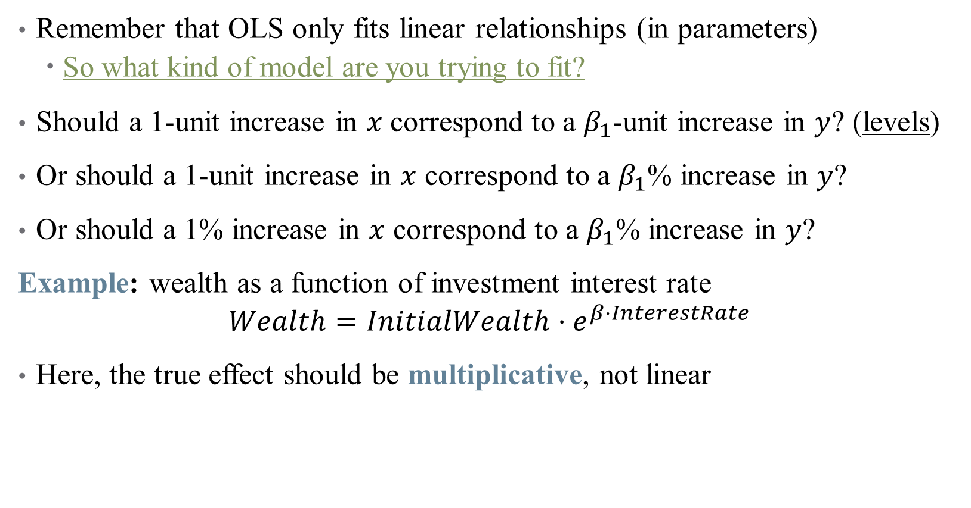
Nonlinear Transformations: Achieving “Linearity” (?)
Remember that OLS only fits linear relationships (in parameters)
So what kind of model are you trying to fit?
Should a 1-unit increase in $x$ correspond to a $β_{1}$-unit increase in $y$? (levels)
Or should a 1-unit increase in $x$ correspond to a $β_{1}$% increase in $y$?
Or should a 1% increase in $x$ correspond to a $β_{1}$% increase in $y$?
Example: wealth as a function of investment interest rate
$$Wealth=InitialWealth⋅e^{β⋅InterestRate}$$
Here, the true effect should be multiplicative, not linear
Notes:
How to get this in a regression? Use the natural log! Do this on the board.

Slide 20
What kinds of transformations exist?
See “The Effect” for a (more) exhaustive list (pg. 214)
Natural Log – tried and true
But, recall that ln(0) is undefined – what if we have zero-valued data?

Slide 21
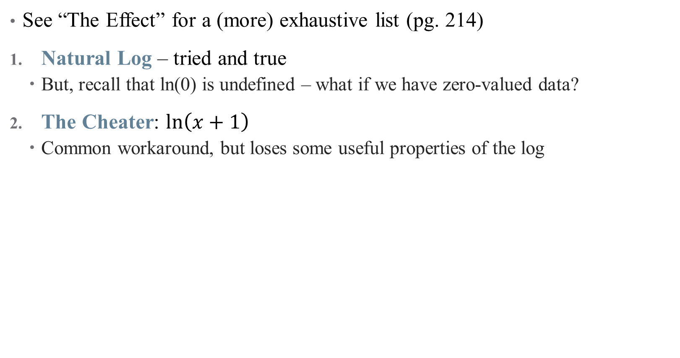
What kinds of transformations exist?
See “The Effect” for a (more) exhaustive list (pg. 214)
Natural Log – tried and true
But, recall that ln(0) is undefined – what if we have zero-valued data?
The Cheater: $ln\left(x+1\right)$
Common workaround, but loses some useful properties of the log
Notes:
If x is large, log(x+1) \approx. log(x). So this works for like health spending or income data, and is defined for 0s. Hence, percentages don’t really work for small x.

Slide 22
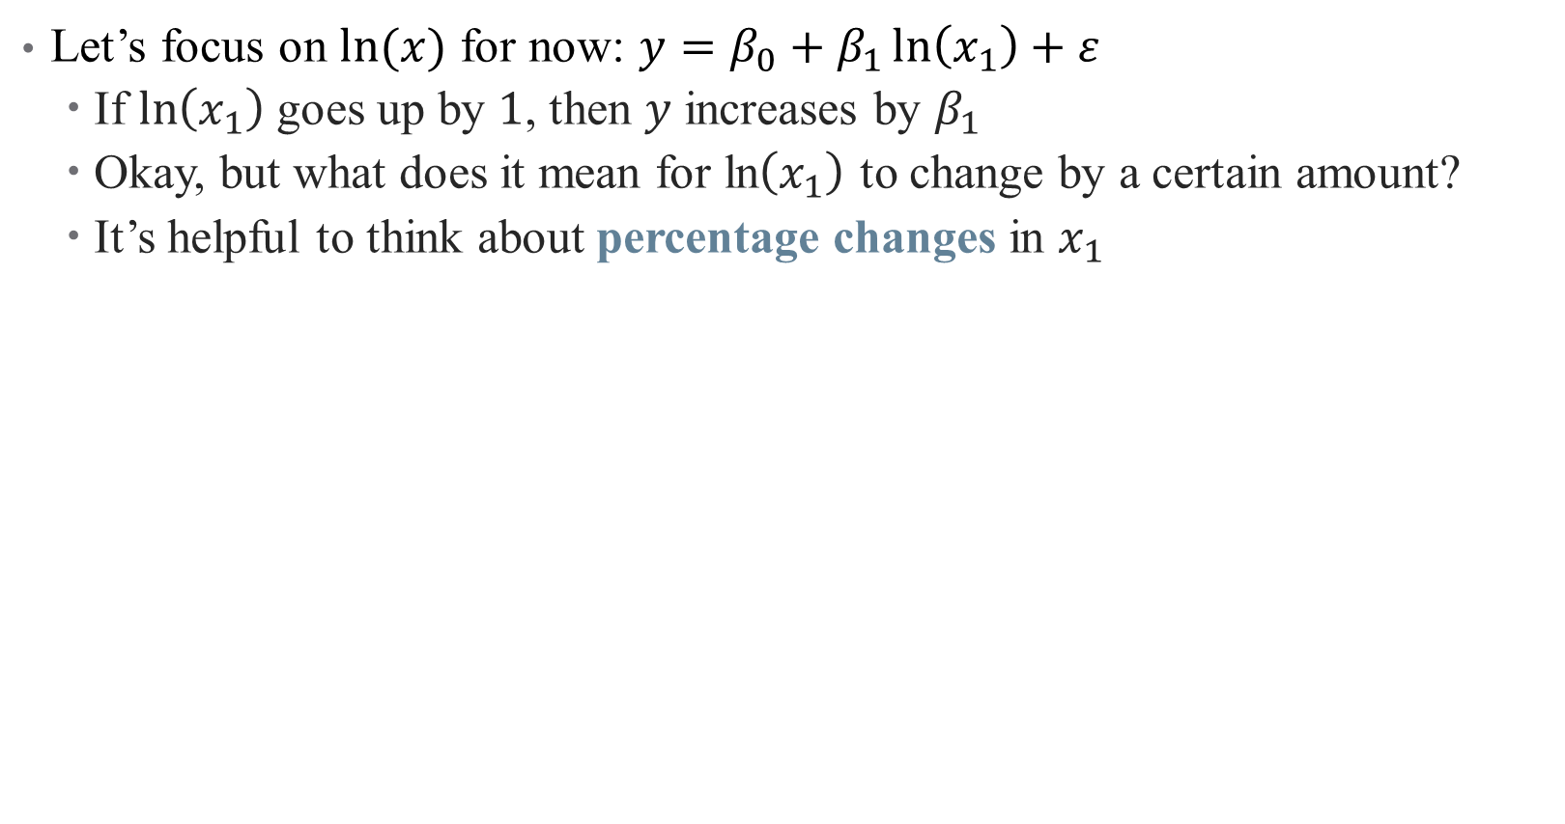
How to interpret coefficients on transformed variables?
Let’s focus on $ln⁡(x)$ for now: $y=β_{0}+β_{1}\ln\left(x_{1}\right)+ε$
If $\ln\left(x_{1}\right)$ goes up by $1$, then $y$ increases by $β_{1}$
Okay, but what does it mean for ln$\left(x_{1}\right)$ to change by a certain amount?
It’s helpful to think about percentage changes in $x_{1}$

Slide 23
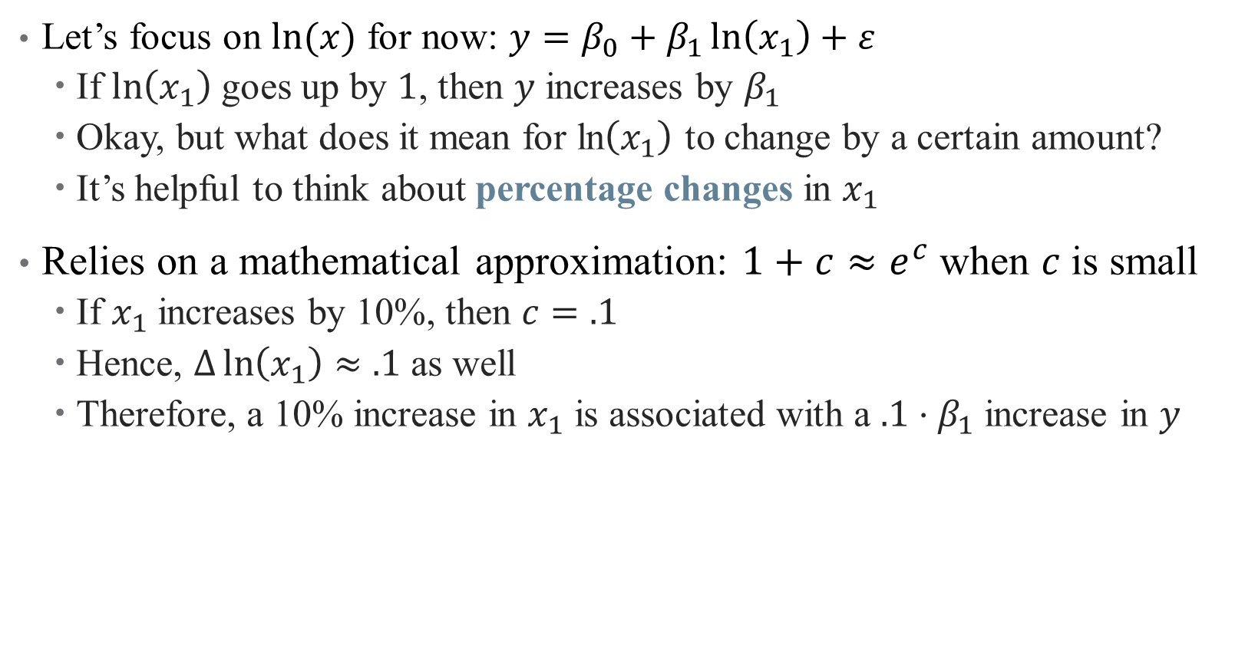
How to interpret coefficients on transformed variables?
Let’s focus on $ln⁡(x)$ for now: $y=β_{0}+β_{1}\ln\left(x_{1}\right)+ε$
If $\ln\left(x_{1}\right)$ goes up by $1$, then $y$ increases by $β_{1}$
Okay, but what does it mean for ln$\left(x_{1}\right)$ to change by a certain amount?
It’s helpful to think about percentage changes in $x_{1}$
Relies on a mathematical approximation: $1+c≈e^{c}$when $c$is small
If $x_{1}$ increases by 10%, then $c=.1$
Hence, $Δ\ln\left(x_{1}\right)≈.1$ as well
Therefore, a 10% increase in $x_{1}$ is associated with a $.1⋅β_{1}$ increase in $y$

Slide 24
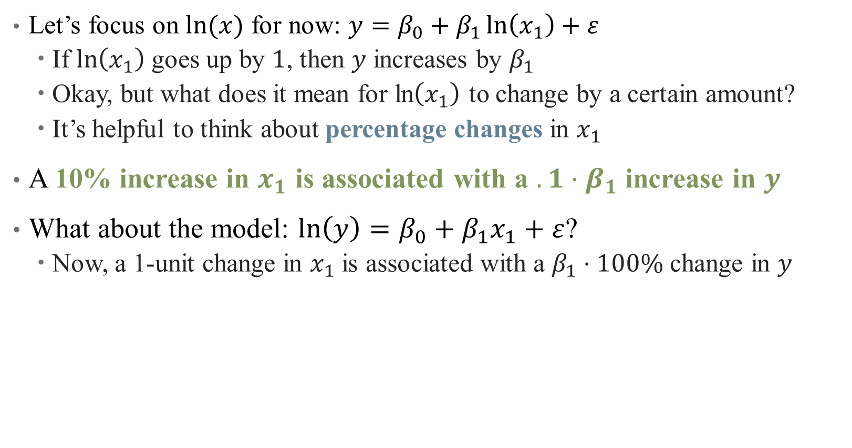
How to interpret coefficients on transformed variables?
Let’s focus on $ln⁡(x)$ for now: $y=β_{0}+β_{1}\ln\left(x_{1}\right)+ε$
If $\ln\left(x_{1}\right)$ goes up by $1$, then $y$ increases by $β_{1}$
Okay, but what does it mean for ln$\left(x_{1}\right)$ to change by a certain amount?
It’s helpful to think about percentage changes in $x_{1}$
A 10% increase in $x_{1}$ is associated with a $.1⋅β_{1}$ increase in $y$
What about the model: $ln\left(y\right)=β_{0}+β_{1}x_{1}+ε$?
Now, a 1-unit change in $x_{1}$ is associated with a $β_{1}⋅100\%$ change in $y$
Notes:
Just the same as before, but one of the variables is in percent and one is in levels – just depends which one you want

Slide 25
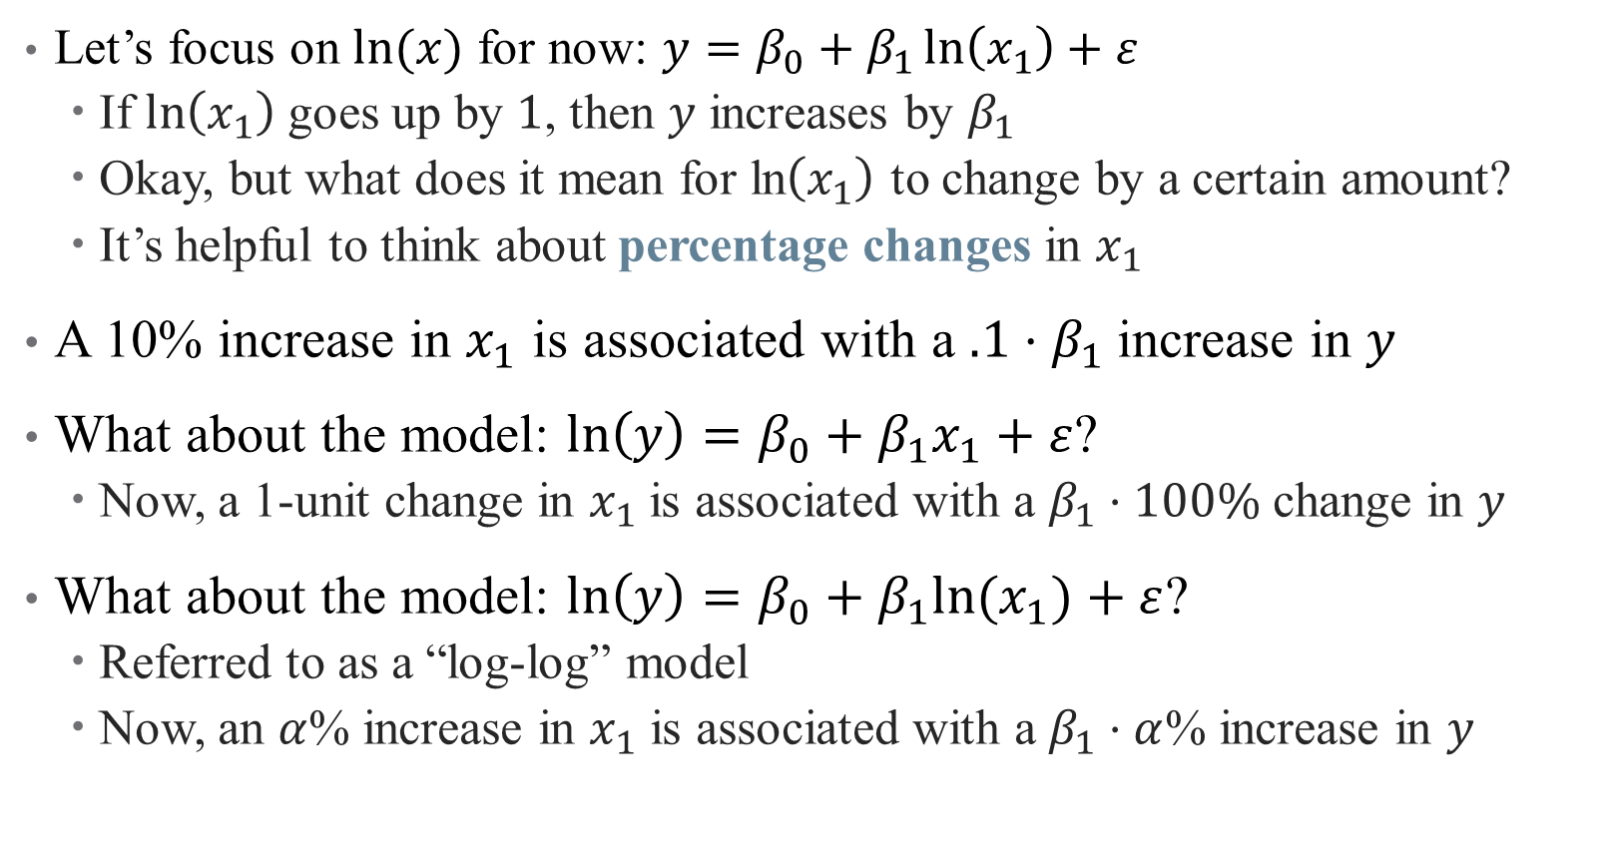
How to interpret coefficients on transformed variables?
Let’s focus on $ln⁡(x)$ for now: $y=β_{0}+β_{1}\ln\left(x_{1}\right)+ε$
If $\ln\left(x_{1}\right)$ goes up by $1$, then $y$ increases by $β_{1}$
Okay, but what does it mean for ln$\left(x_{1}\right)$ to change by a certain amount?
It’s helpful to think about percentage changes in $x_{1}$
A 10% increase in $x_{1}$ is associated with a $.1⋅β_{1}$ increase in $y$
What about the model: $ln\left(y\right)=β_{0}+β_{1}x_{1}+ε$?
Now, a 1-unit change in $x_{1}$ is associated with a $β_{1}⋅100\%$ change in $y$
What about the model: $ln\left(y\right)=β_{0}+β_{1}{ln⁡(x}_{1})+ε$?
Referred to as a “log-log” model
Now, an $α$% increase in $x_{1}$ is associated with a $β_{1}⋅α$% increase in $y$
Notes:
This is the version where both are in percentages.

Slide 26
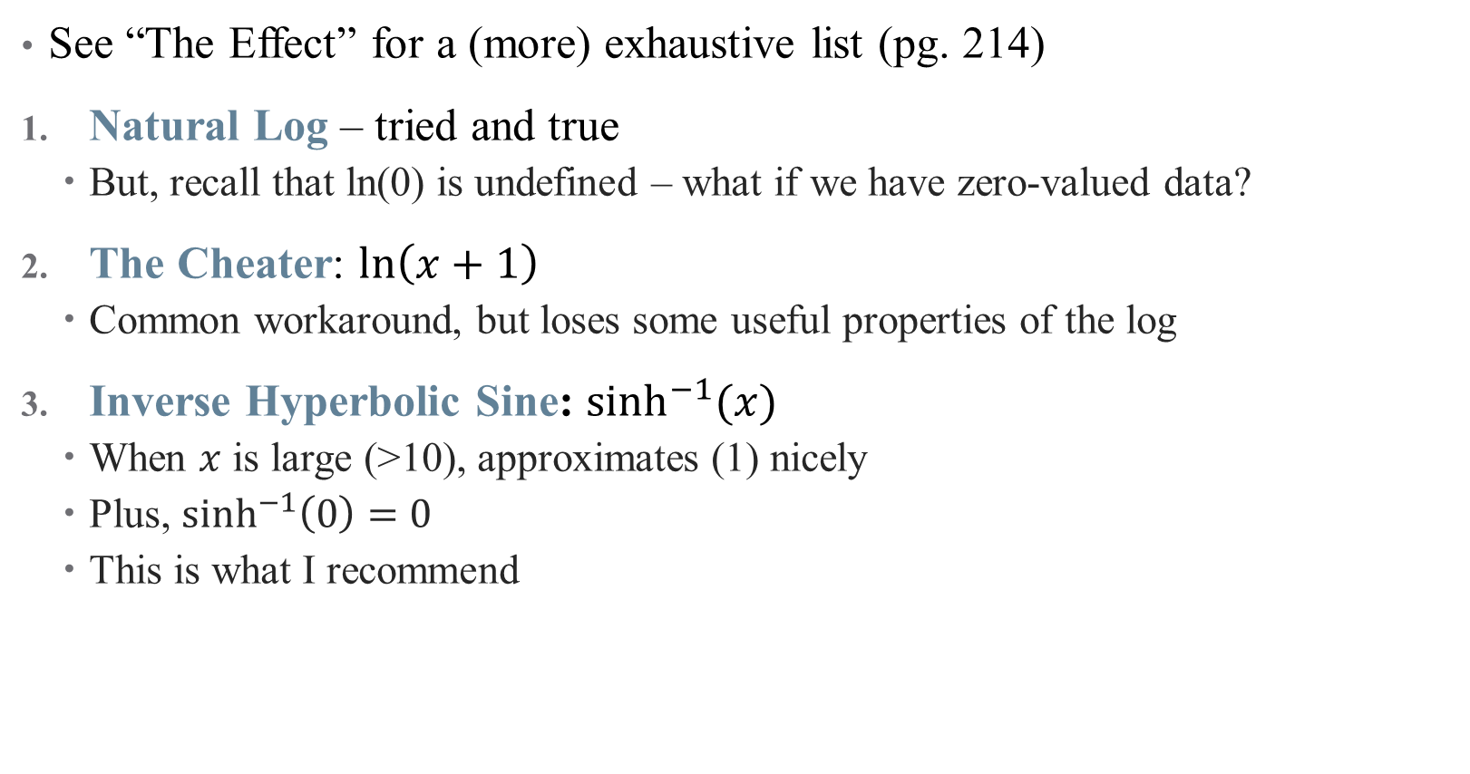
What kinds of transformations exist?
See “The Effect” for a (more) exhaustive list (pg. 214)
Natural Log – tried and true
But, recall that ln(0) is undefined – what if we have zero-valued data?
The Cheater: $ln\left(x+1\right)$
Common workaround, but loses some useful properties of the log
Inverse Hyperbolic Sine: $\sinh^{−1}{(x)}$
When $x$ is large (>10), approximates (1) nicely
Plus, $\sinh^{−1}\left(0\right)=0$
This is what I recommend
Notes:
This is the hipster one – do it and you’re cool. Can also handle negative numbers if you need

Slide 27
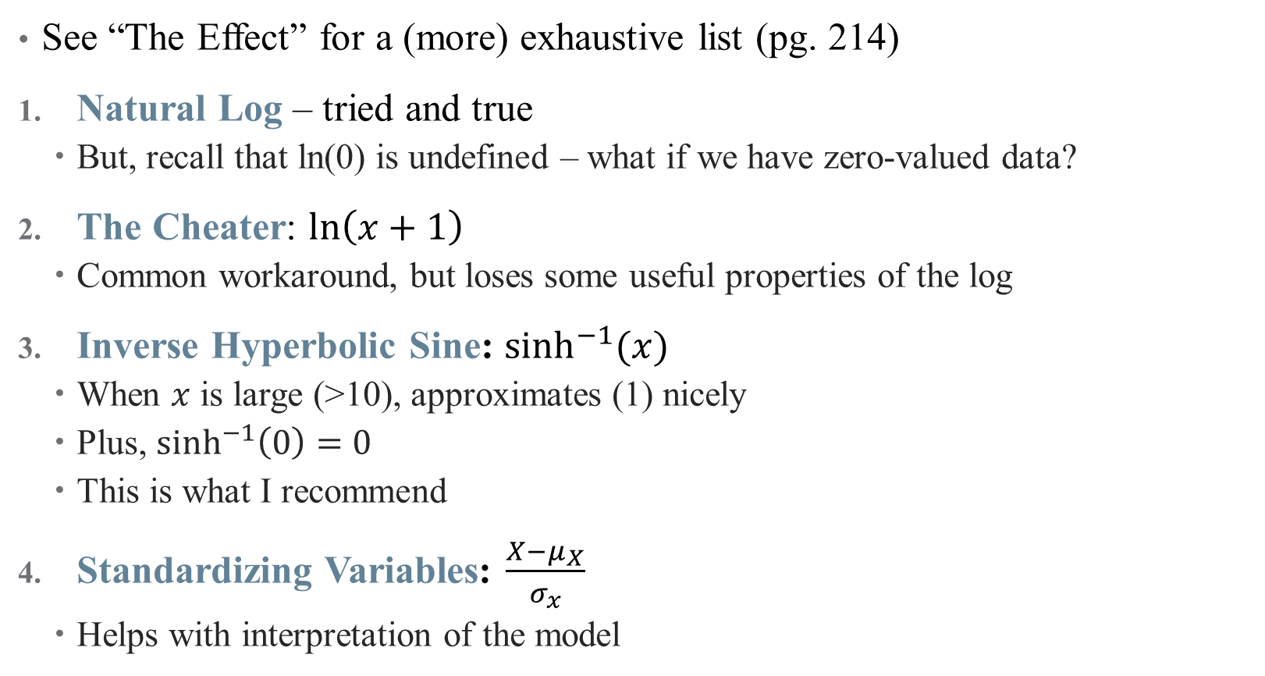
What kinds of transformations exist?
See “The Effect” for a (more) exhaustive list (pg. 214)
Natural Log – tried and true
But, recall that ln(0) is undefined – what if we have zero-valued data?
The Cheater: $ln\left(x+1\right)$
Common workaround, but loses some useful properties of the log
Inverse Hyperbolic Sine: $\sinh^{−1}{(x)}$
When $x$ is large (>10), approximates (1) nicely
Plus, $\sinh^{−1}\left(0\right)=0$
This is what I recommend
Standardizing Variables: $\frac{X−μ_{X}}{σ_{x}}$
Helps with interpretation of the model
What does our case study use?
Notes:
This is a common practice if the units are already weird (e.g., points on a happiness scale), and moves to more data-driven units. (another not shown is square root)

Slide 28
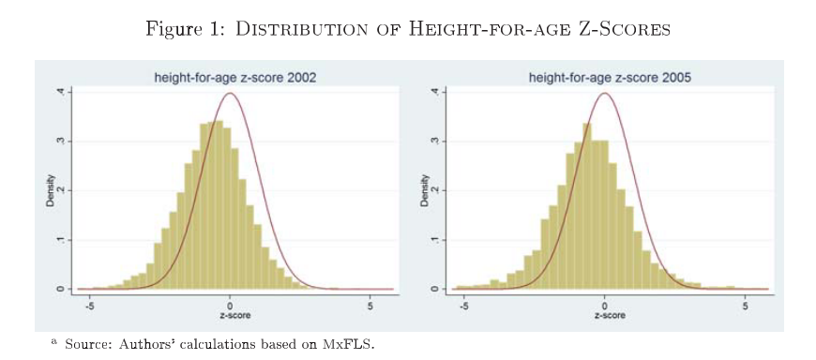
Case Study: Why transform an outcome variable?
Notes:
Here, we are taking each child’s height and comparing it to a reference population (matching based on age), then standardizing. So what are the final units? How do we interpret these graphs? Importantly, how will this affect our regression coefficients?

Slide 29
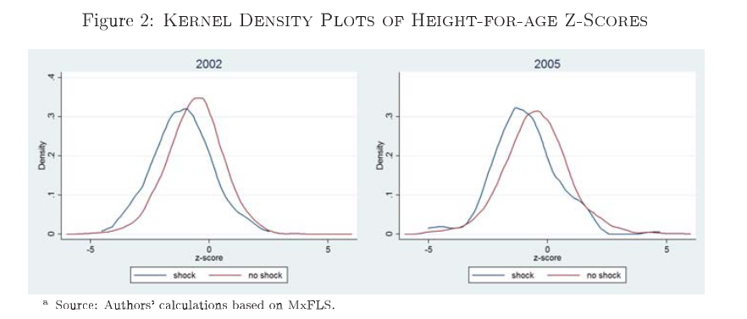
Case study: descriptive evidence
Notes:
Do not underestimate descriptive evidence! This is huge!

Slide 30
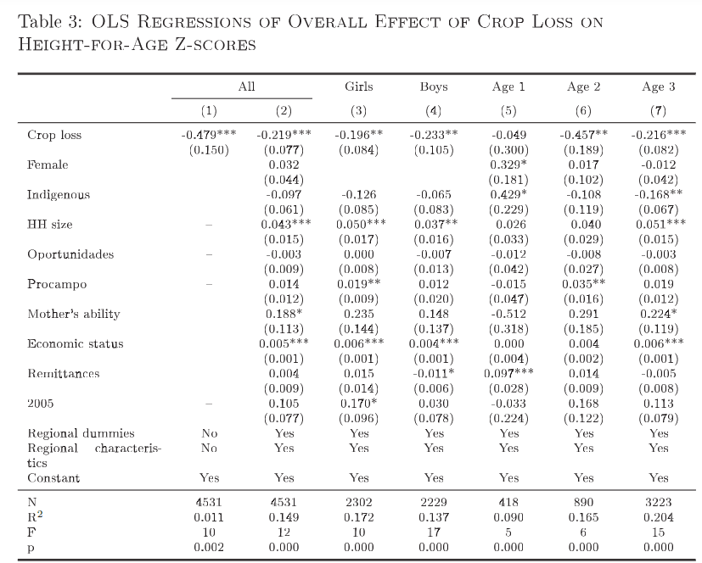
Case study: Interpreting a regression
Notes:
What do we see here? How do we interpret it? Do we need to go through each coefficient here? What is causal and what is not?

Slide 31
Mini Referee Report
What do you think about these papers?
Any concerns?
Anything clever?
What would you extend?
Notes:
I don’t particularly like this model (too macro, relies too much on dynamics). What did others think?

Slide 32
Interaction Effects

Slide 33
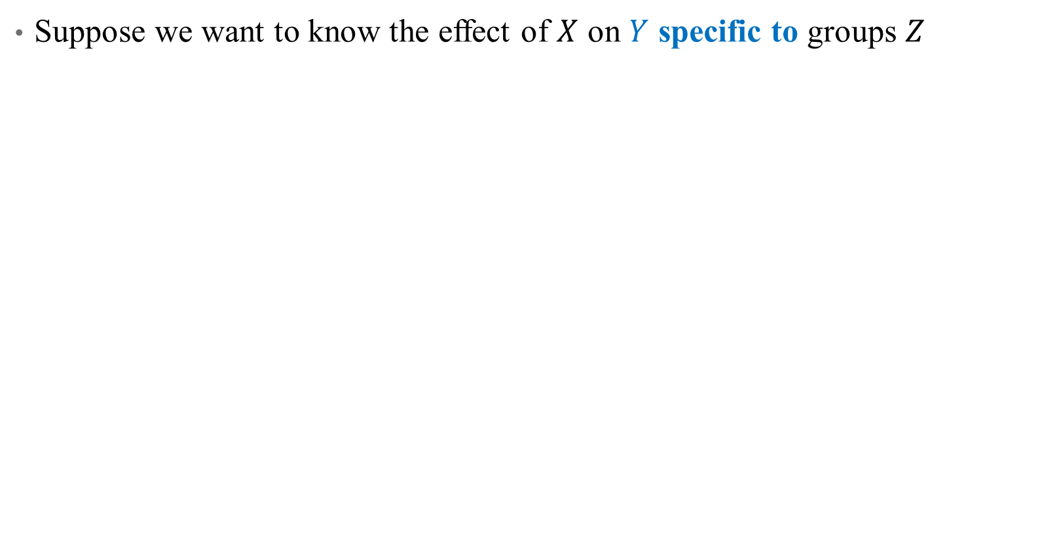
What is an Interaction?
Suppose we want to know the effect of $X$ on $Y$ specific to groups $Z$
Notes:
Example: what is the effect of radiology on survival? Well that depends on different groups of cancer patients

Slide 34
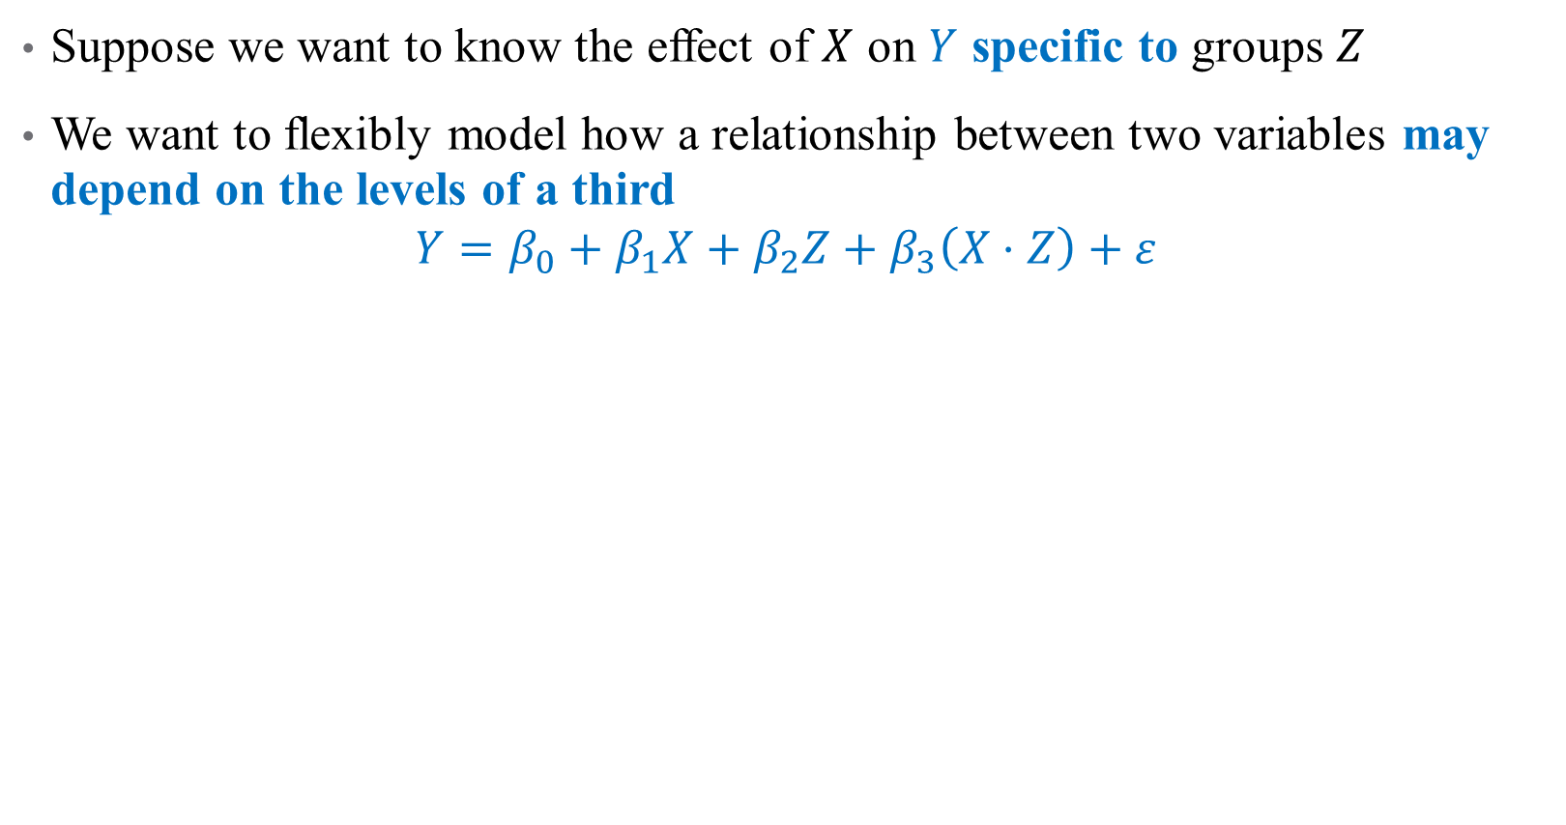
What is an Interaction?
Suppose we want to know the effect of $X$ on $Y$ specific to groups $Z$
We want to flexibly model how a relationship between two variables may depend on the levels of a third
$$Y=β_{0}+β_{1}X+β_{2}Z+β_{3}\left(X⋅Z\right)+ε$$
Notes:
We add what’s called an interaction term – here, X is the effect of radiation, and Z is an indicator variable for different type of cancer. What do each of the coefficients mean?

Slide 35
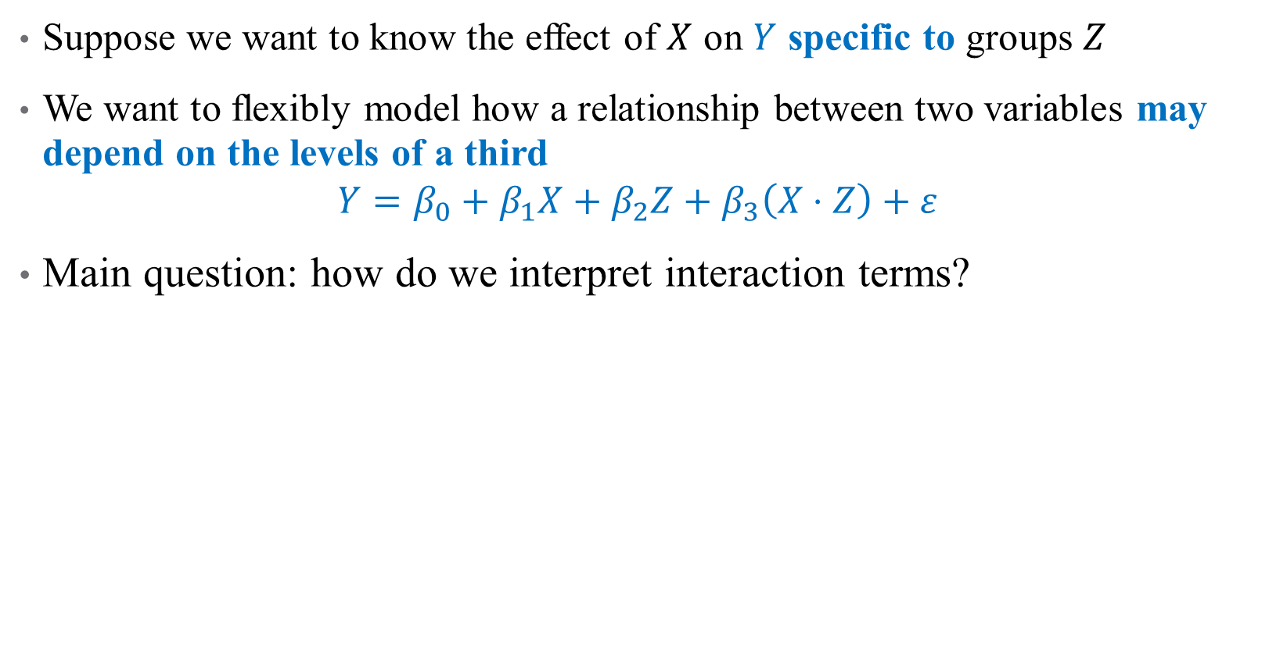
What is an Interaction?
Suppose we want to know the effect of $X$ on $Y$ specific to groups $Z$
We want to flexibly model how a relationship between two variables may depend on the levels of a third
$$Y=β_{0}+β_{1}X+β_{2}Z+β_{3}\left(X⋅Z\right)+ε$$
Main question: how do we interpret interaction terms?
Notes:
We can interpret coefs 1 and 2 easily, what about 3?

Slide 36
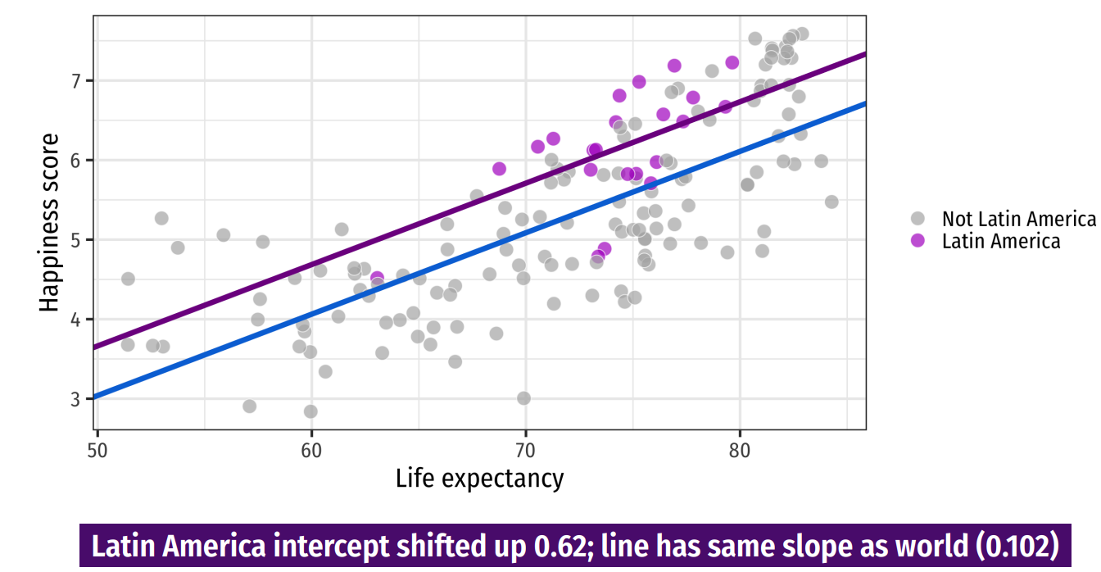
Discrete Regressors
Notes:
We don’t have an interaction model in our case study (what might it be?) so let’s circle back there. This is from last time – the impact of including a dummy is an intercept shift

Slide 37
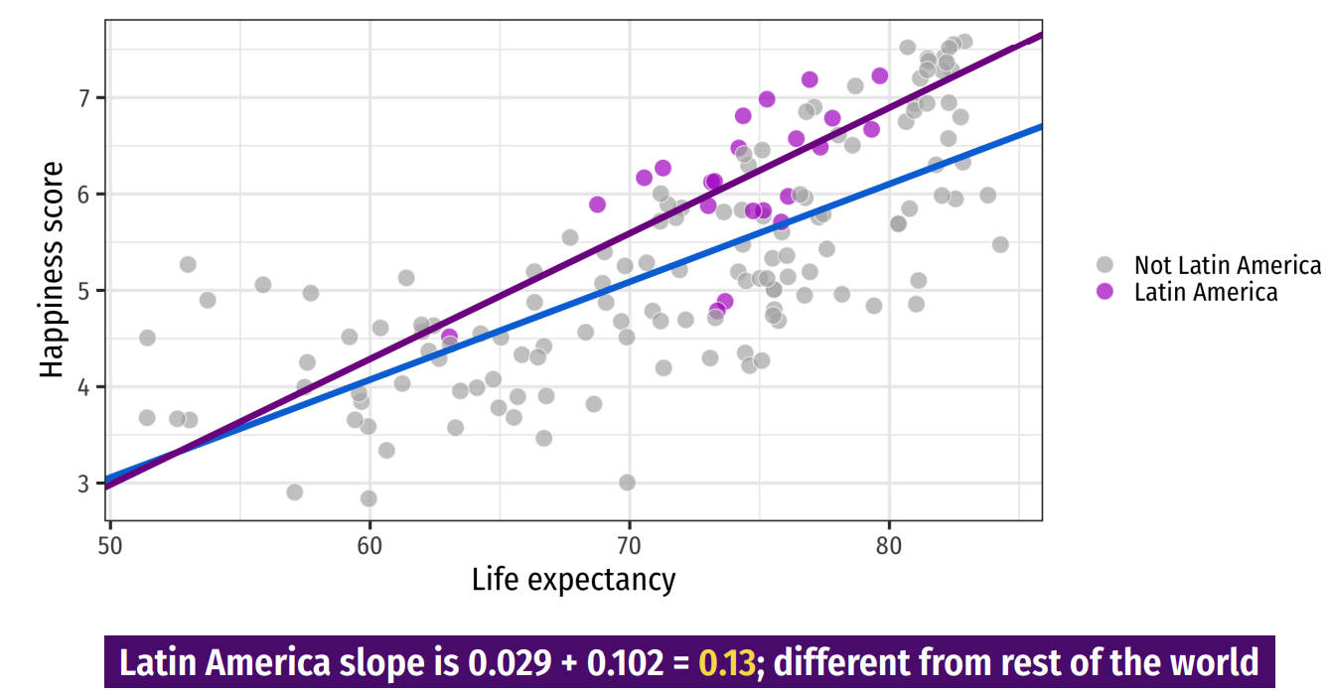
Discrete Regressors
Notes:
An interaction is a change in slope for two groups – here, we estimate happiness as a function of life expectancy * (latin America) to get separate slopes for each region

Slide 38
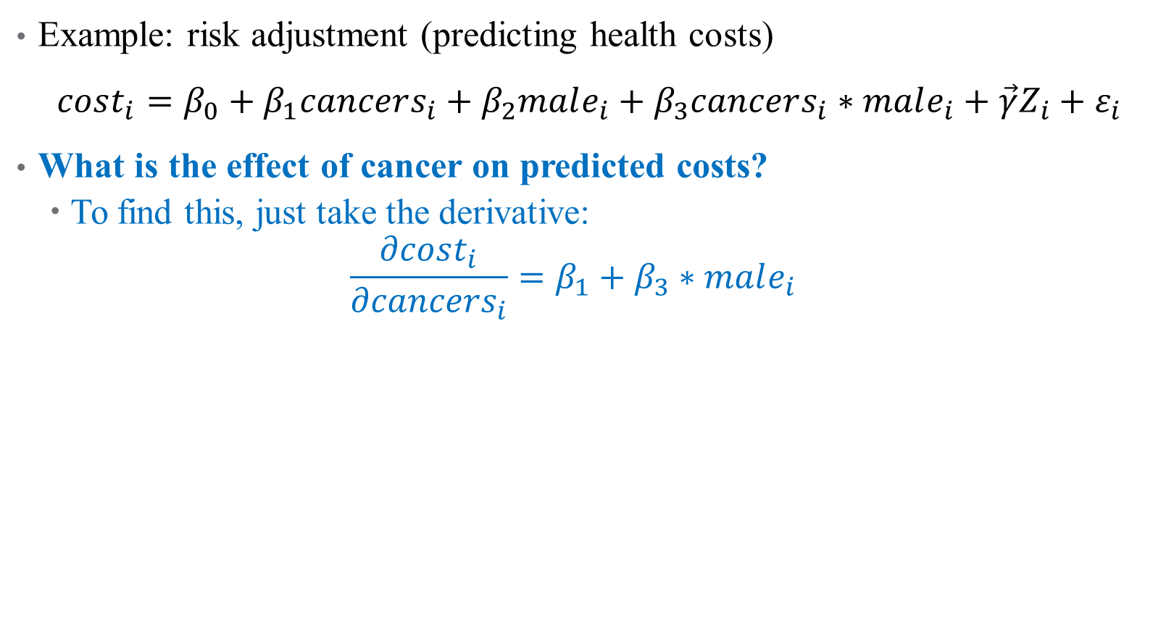
How do we Interpret Interaction Terms?
Example: risk adjustment (predicting health costs)
$cost_{i}=β_{0}+β_{1}cancers_{i}+β_{2}male_{i}+β_{3}cancers_{i}∗male_{i}+\vec{γ}Z_{i}+ε_{i}$
What is the effect of cancer on predicted costs?
To find this, just take the derivative:
$$\frac{∂cost_{i}}{∂cancers_{i}}=β_{1}+β_{3}∗male_{i}$$
Notes:
Interaction terms are everywhere in risk adjustment!

Slide 39
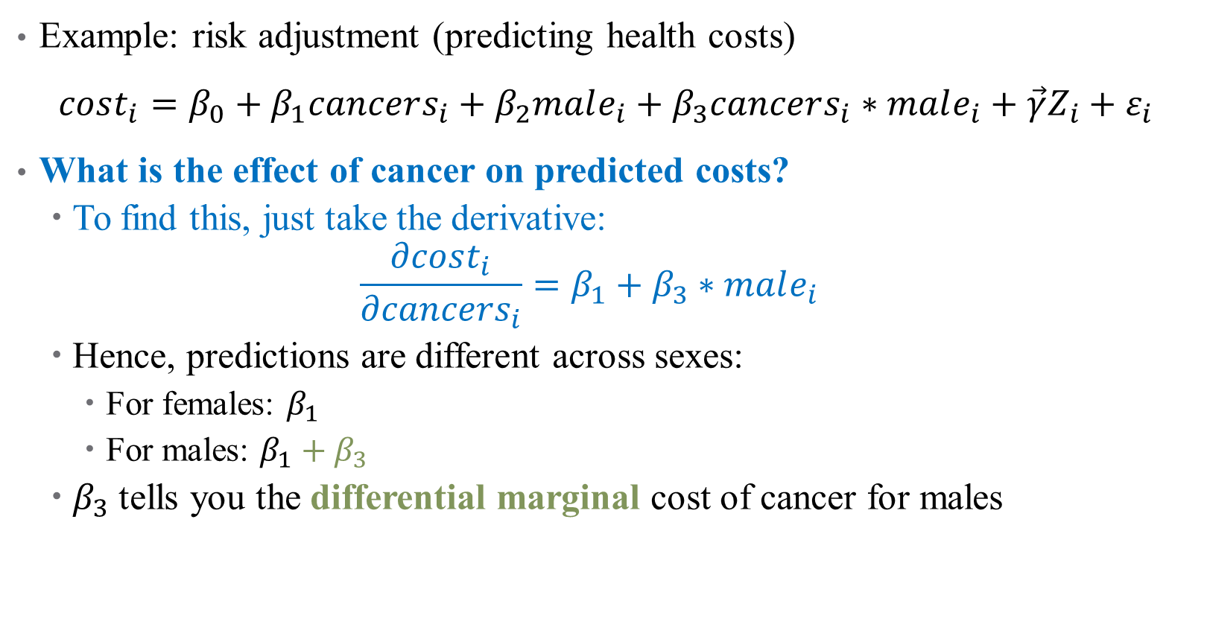
How do we Interpret Interaction Terms?
Example: risk adjustment (predicting health costs)
$cost_{i}=β_{0}+β_{1}cancers_{i}+β_{2}male_{i}+β_{3}cancers_{i}∗male_{i}+\vec{γ}Z_{i}+ε_{i}$
What is the effect of cancer on predicted costs?
To find this, just take the derivative:
$$\frac{∂cost_{i}}{∂cancers_{i}}=β_{1}+β_{3}∗male_{i}$$
Hence, predictions are different across sexes:
For females: $β_{1}$
For males: $β_{1}+β_{3}$
$β_{3}$ tells you the differential marginal cost of cancer for males
Notes:
Not just a level shift, but different margin here.

Slide 40
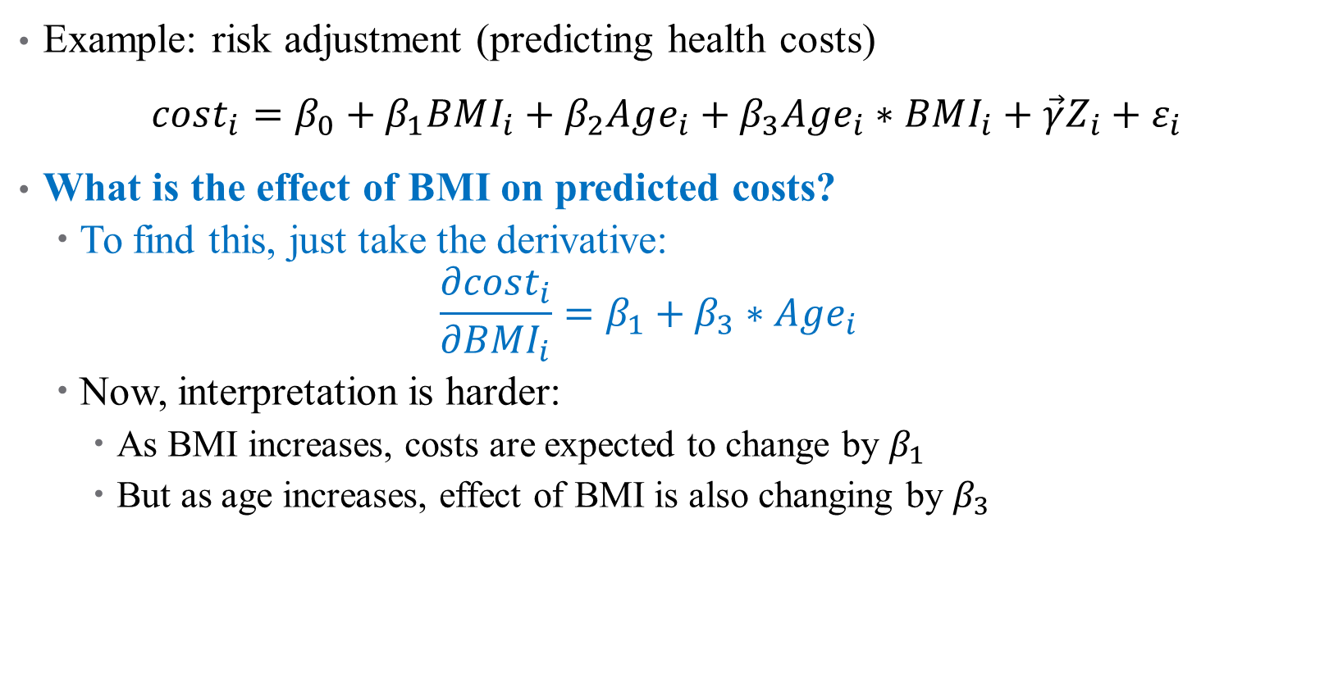
What about Continuous Interactions?
Example: risk adjustment (predicting health costs)
$cost_{i}=β_{0}+β_{1}BMI_{i}+β_{2}Age_{i}+β_{3}Age_{i}∗BMI_{i}+\vec{γ}Z_{i}+ε_{i}$
What is the effect of BMI on predicted costs?
To find this, just take the derivative:
$$\frac{∂cost_{i}}{∂BMI_{i}}=β_{1}+β_{3}∗Age_{i}$$
Now, interpretation is harder:
As BMI increases, costs are expected to change by $β_{1}$
But as age increases, effect of BMI is also changing by $β_{3}$
Notes:
Typically, interactions make more sense when one of the variables is categorical, but you can estimate this. For interpretation, you would generally “pin down” a comparison (e.g., say the change in marginal effect of BMI on costs for a 50-yo to a 60-yo)

Slide 41
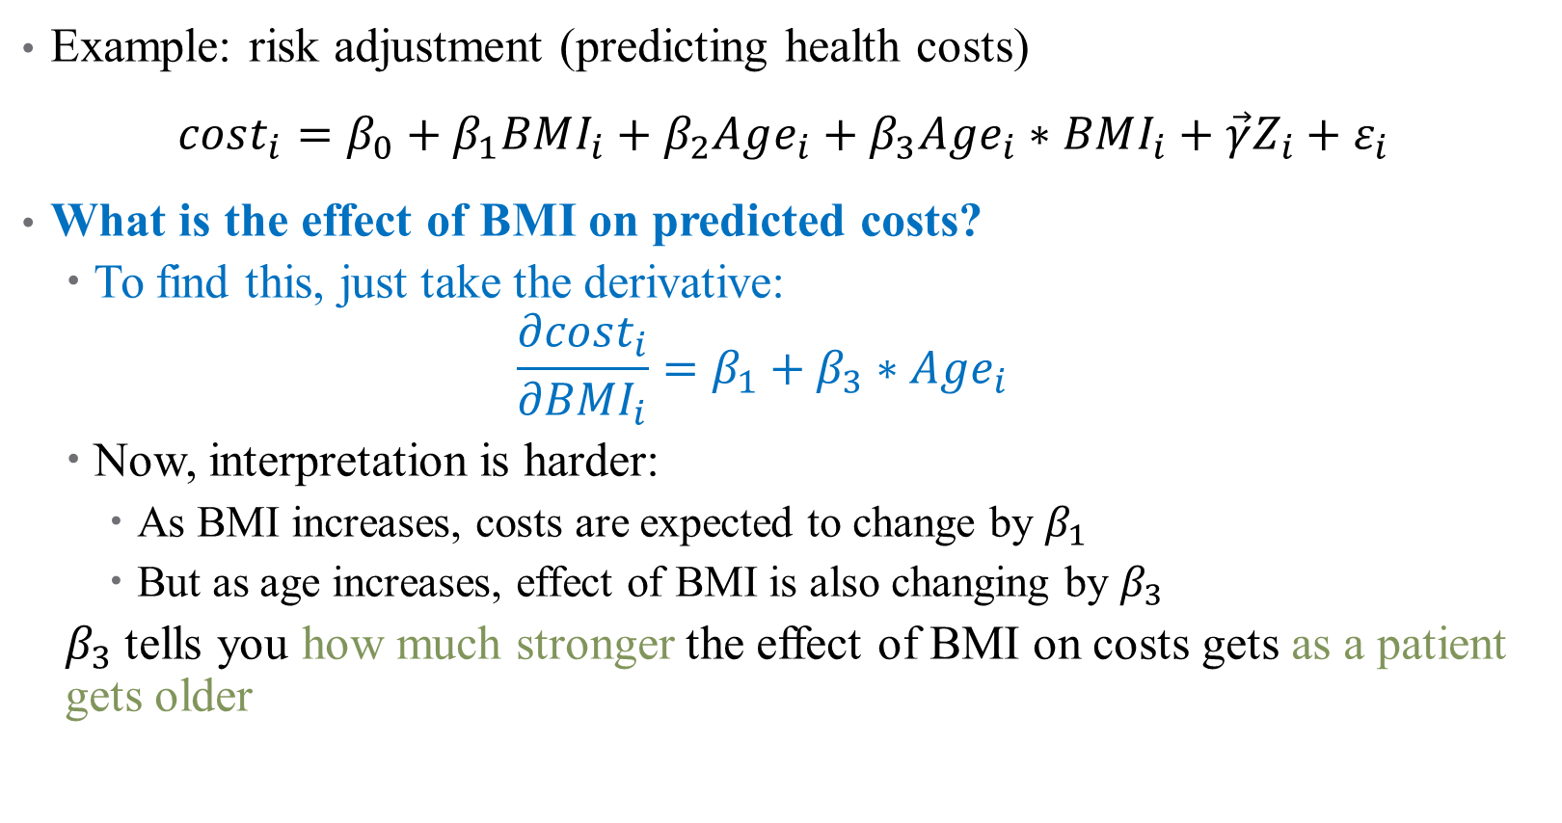
What about Continuous Interactions?
Example: risk adjustment (predicting health costs)
$cost_{i}=β_{0}+β_{1}BMI_{i}+β_{2}Age_{i}+β_{3}Age_{i}∗BMI_{i}+\vec{γ}Z_{i}+ε_{i}$
What is the effect of BMI on predicted costs?
To find this, just take the derivative:
$$\frac{∂cost_{i}}{∂BMI_{i}}=β_{1}+β_{3}∗Age_{i}$$
Now, interpretation is harder:
As BMI increases, costs are expected to change by $β_{1}$
But as age increases, effect of BMI is also changing by $β_{3}$
$β_{3}$ tells you how much stronger the effect of BMI on costs gets as a patient gets older

Slide 42
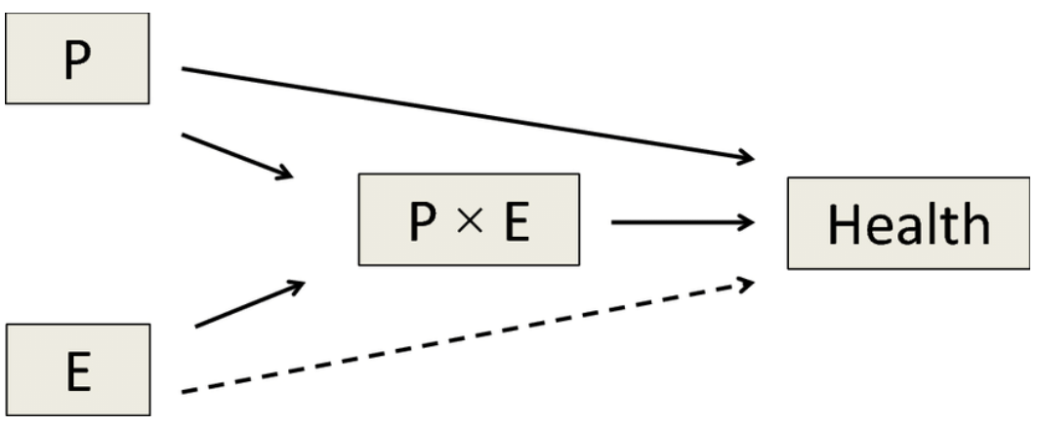
Interactions in Practice
Always include all pieces of an interaction in the full model
Much harder to interpret
Have a strong theoretical reason to justify inclusion
Too easy to get false positives
Effects are generally noisy
You’re exploiting variation across 2 noisy variables already
Will need large sample size
Notes:
Note on 1 – R will mostly do this for you, but don’t leave it up to chance. You have to do this to not keep open back doors (DAG) Note on 2: if we let the data do whatever it wants, we’ll find results that don’t mean much.

Slide 43
Nonlinear Models (pt. 1)
Notes:
Skip this bit if you want – or defer to appendix for future slides.

Slide 44
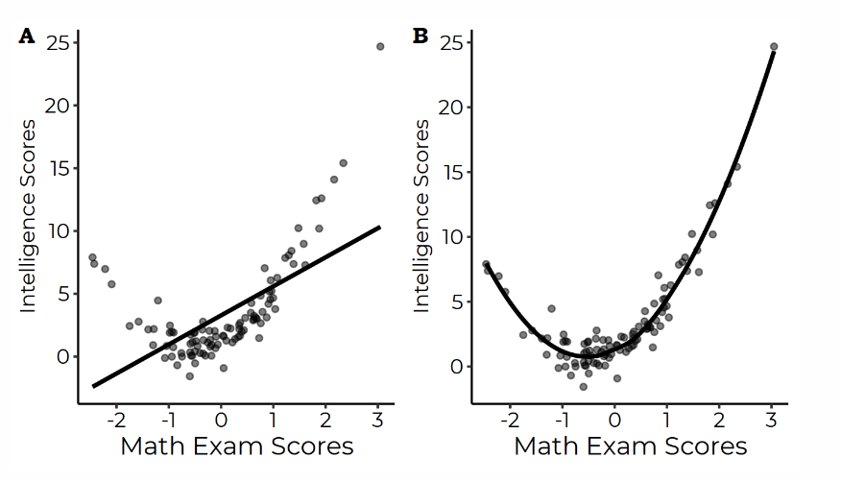
Nonlinearities
Sometimes, a linear model isn’t enough (even after transformations)

Slide 45
Could we transform this data?
When data can be transformed to accommodate linear relationships, do it
Otherwise, add polynomial terms!

Slide 46
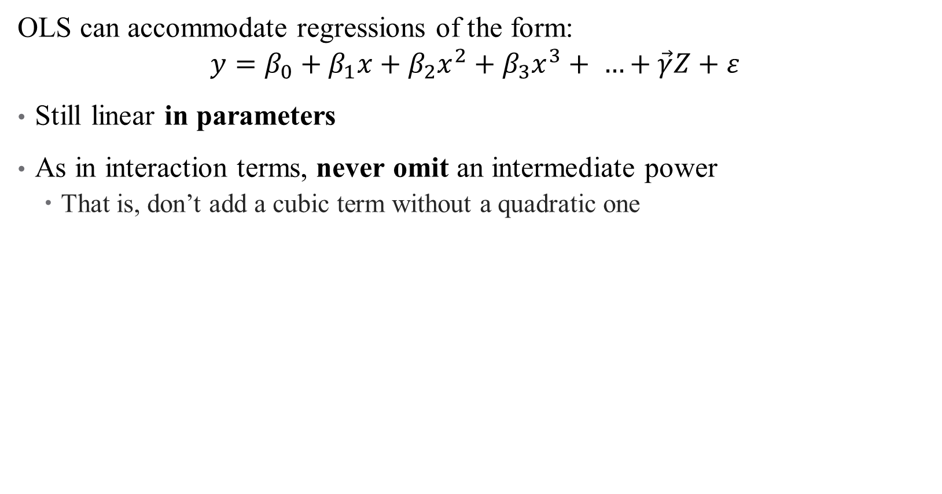
Choosing a Functional Form
OLS can accommodate regressions of the form:
$$y=β_{0}+β_{1}x+β_{2}x^{2}+β_{3}x^{3}+ …+\vec{γ}Z+ε$$
Still linear in parameters
As in interaction terms, never omit an intermediate power
That is, don’t add a cubic term without a quadratic one
Notes:
Remember, OLS is linear in parameters (not necessarily in data) – it just depends how you plan to interpret the parameters of the funky data you’re giving OLS

Slide 47
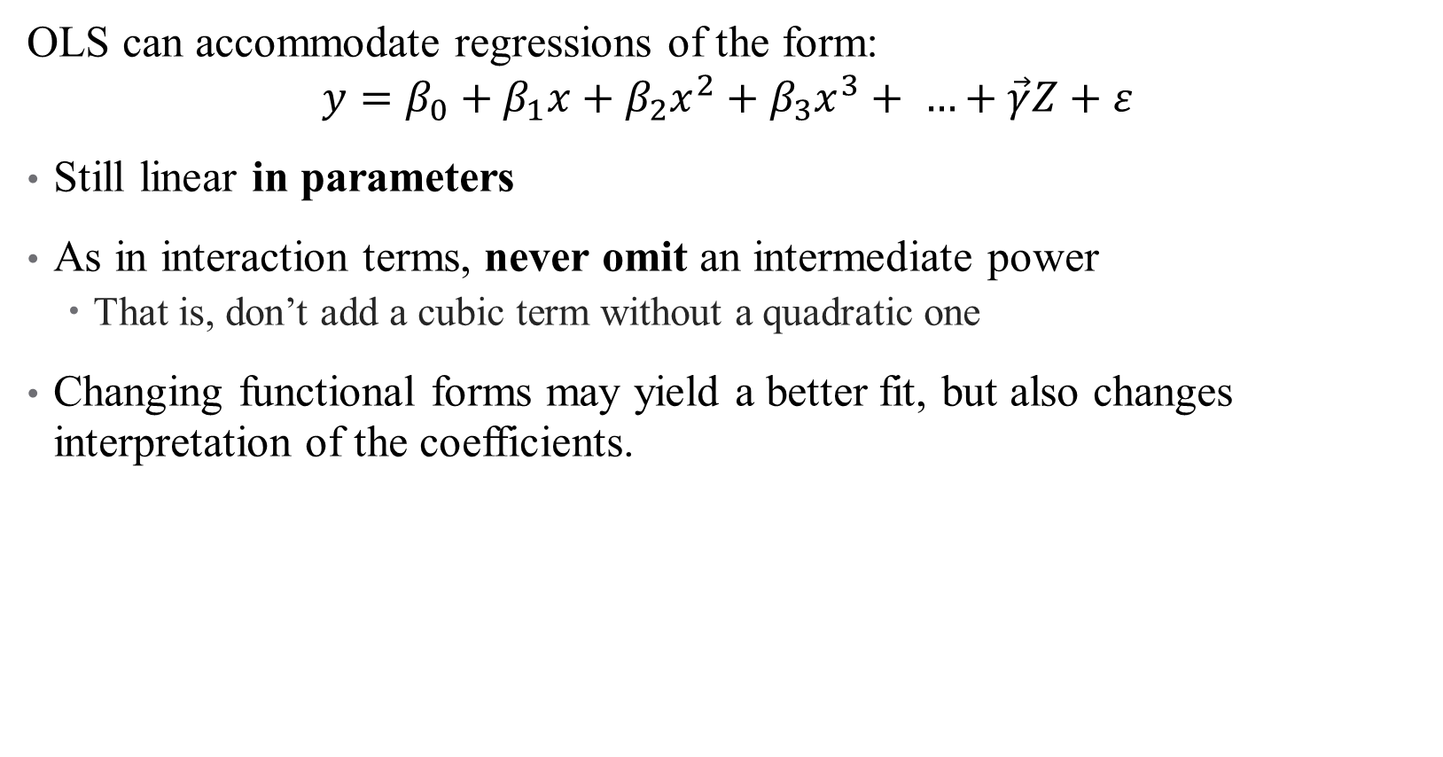
Choosing a Functional Form
OLS can accommodate regressions of the form:
$$y=β_{0}+β_{1}x+β_{2}x^{2}+β_{3}x^{3}+ …+\vec{γ}Z+ε$$
Still linear in parameters
As in interaction terms, never omit an intermediate power
That is, don’t add a cubic term without a quadratic one
Changing functional forms may yield a better fit, but also changes interpretation of the coefficients.

Slide 48
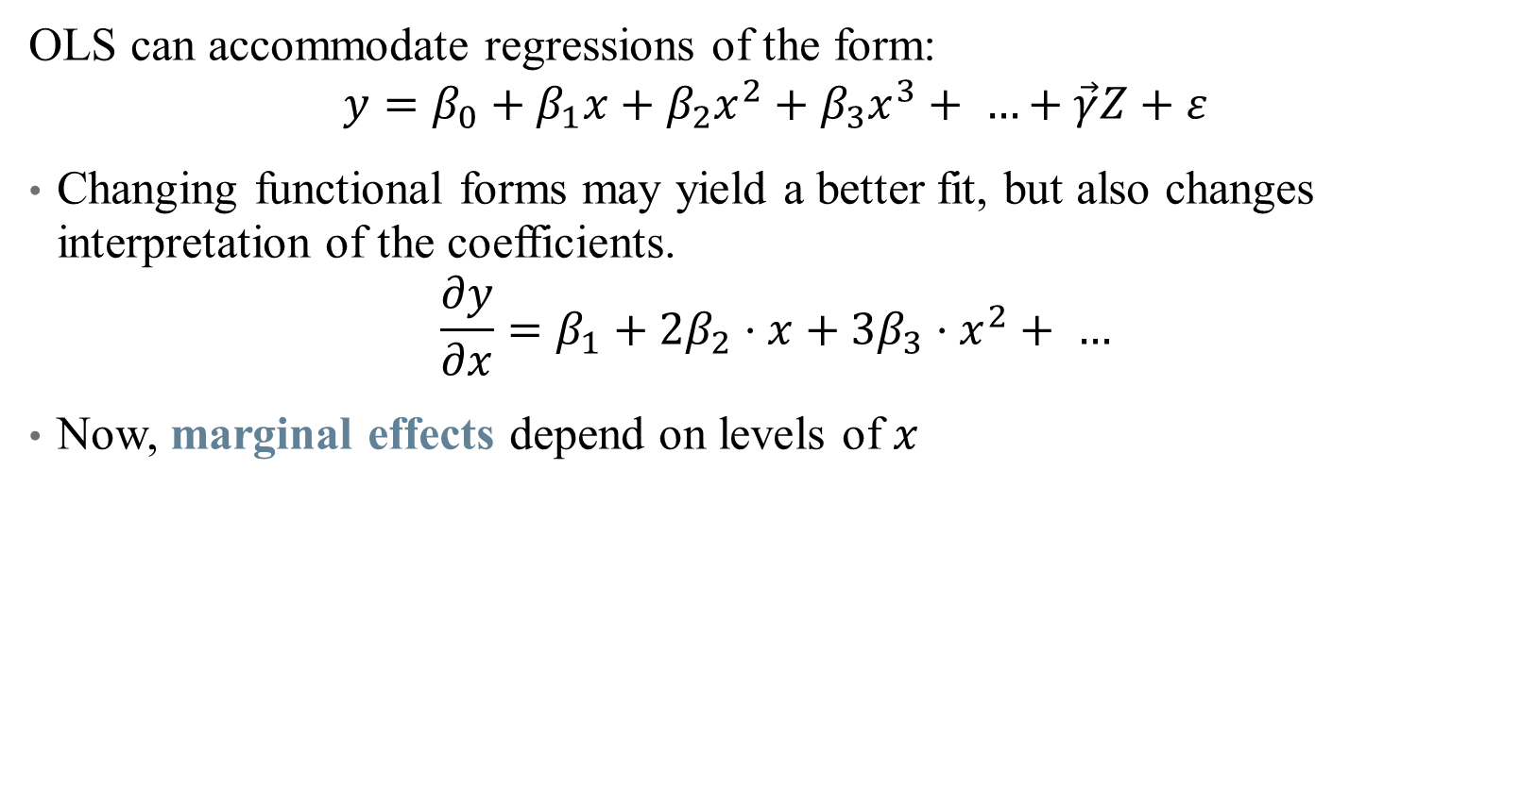
How do we Interpret Coefficients?
OLS can accommodate regressions of the form:
$$y=β_{0}+β_{1}x+β_{2}x^{2}+β_{3}x^{3}+ …+\vec{γ}Z+ε$$
Changing functional forms may yield a better fit, but also changes interpretation of the coefficients.
$$\frac{∂y}{∂x}=β_{1}+2β_{2}⋅x+3β_{3}⋅x^{2}+ …$$
Now, marginal effects depend on levels of $x$
Notes:
So what exactly do you do here? Have to generally pick a level of x (mean, for example) for this to make sense.

Slide 49
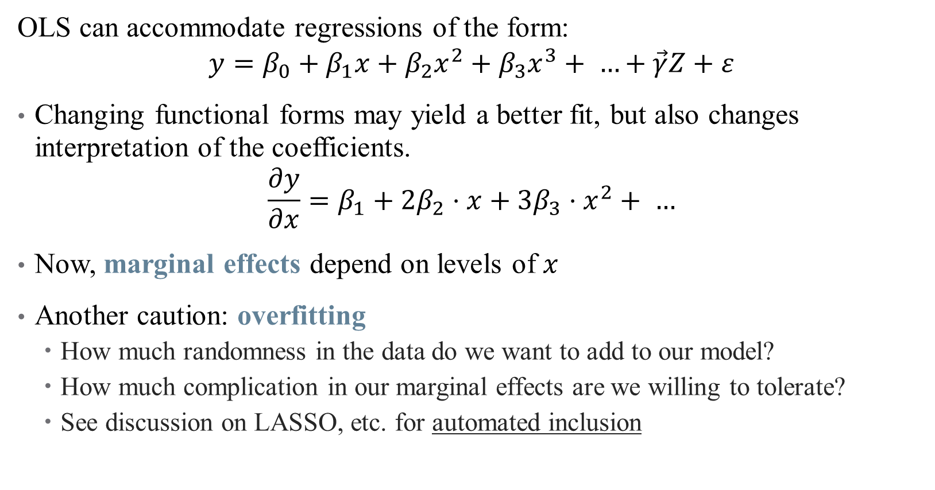
How do we Interpret Coefficients?
OLS can accommodate regressions of the form:
$$y=β_{0}+β_{1}x+β_{2}x^{2}+β_{3}x^{3}+ …+\vec{γ}Z+ε$$
Changing functional forms may yield a better fit, but also changes interpretation of the coefficients.
$$\frac{∂y}{∂x}=β_{1}+2β_{2}⋅x+3β_{3}⋅x^{2}+ …$$
Now, marginal effects depend on levels of $x$
Another caution: overfitting
How much randomness in the data do we want to add to our model?
How much complication in our marginal effects are we willing to tolerate?
See discussion on LASSO, etc. for automated inclusion

Slide 50
Getting the “Right” Standard Errors

Slide 51
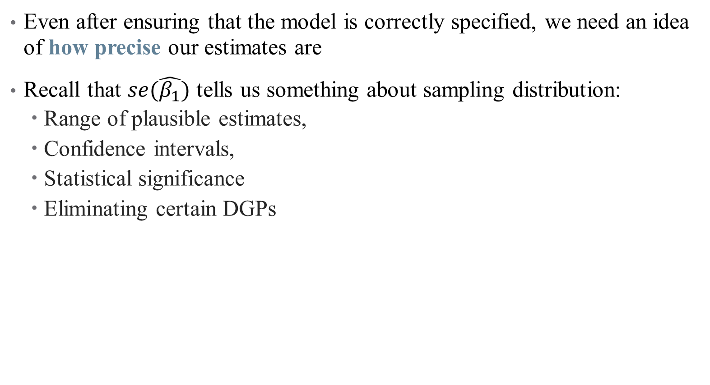
Standard Errors
Even after ensuring that the model is correctly specified, we need an idea of how precise our estimates are
Recall that $se(\hat{β_{1}})$ tells us something about sampling distribution:
Range of plausible estimates,
Confidence intervals,
Statistical significance
Eliminating certain DGPs

Slide 52
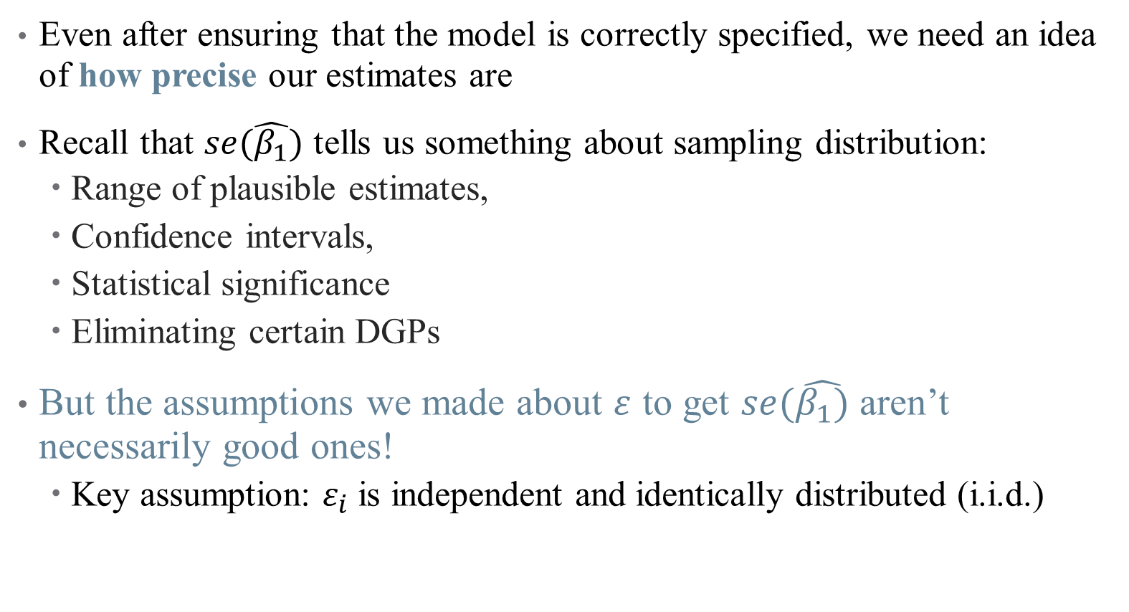
Standard Errors
Even after ensuring that the model is correctly specified, we need an idea of how precise our estimates are
Recall that $se(\hat{β_{1}})$ tells us something about sampling distribution:
Range of plausible estimates,
Confidence intervals,
Statistical significance
Eliminating certain DGPs
But the assumptions we made about $ε$ to get $se(\hat{β_{1})}$ aren’t necessarily good ones!
Key assumption: $ε_{i}$ is independent and identically distributed (i.i.d.)

Slide 53
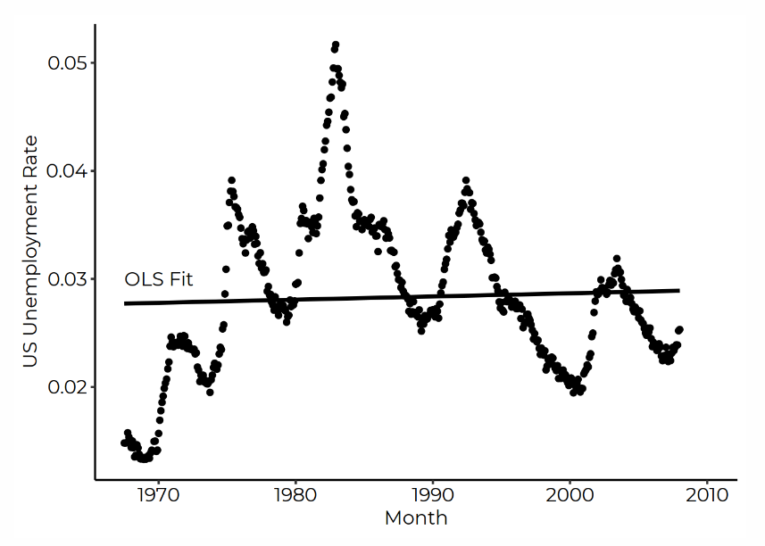
Are my error terms i.i.d.?
Autocorrelation: “Shock” of today is correlated with “shock” from yesterday
Notes:
This is less of a problem in our data, because we rarely use time series data (which is different from panel). We’ll come back to this a little next semester – takeaway is that beta is still unbiased and inconsistent, but we will tend to overestimate significance (we need to inflate our standard errors to account for correlation)

Slide 54
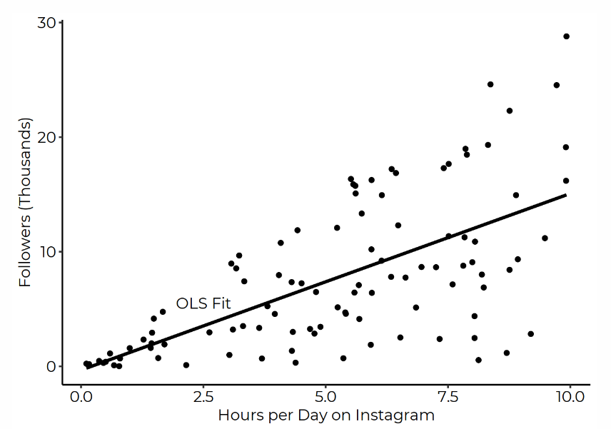
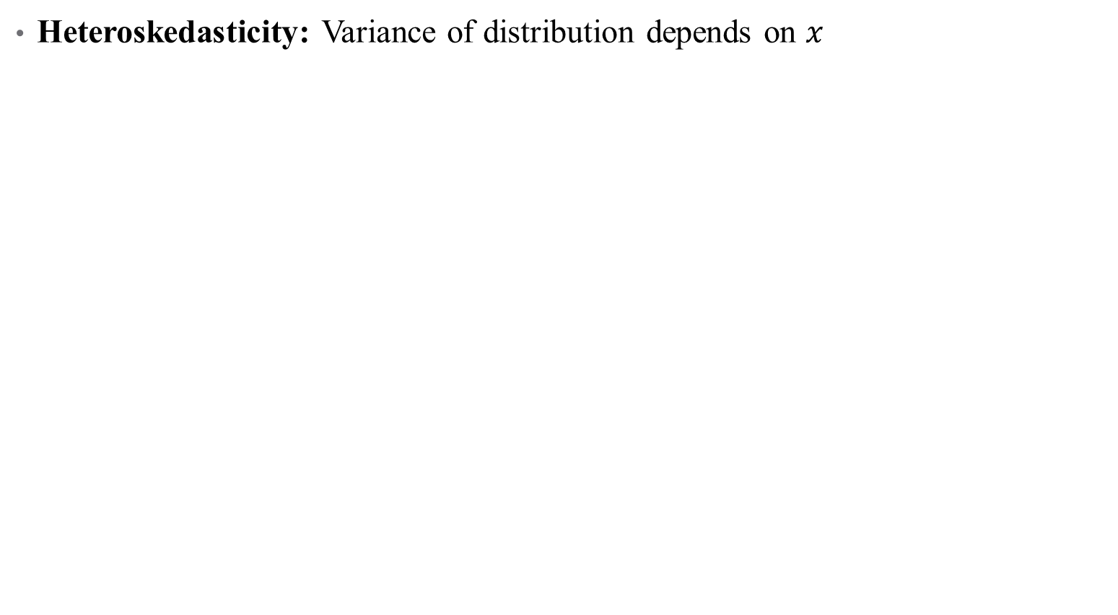
Are my error terms i.i.d.?
Heteroskedasticity: Variance of distribution depends on $x$
Notes:
This is a big one for us!

Slide 55
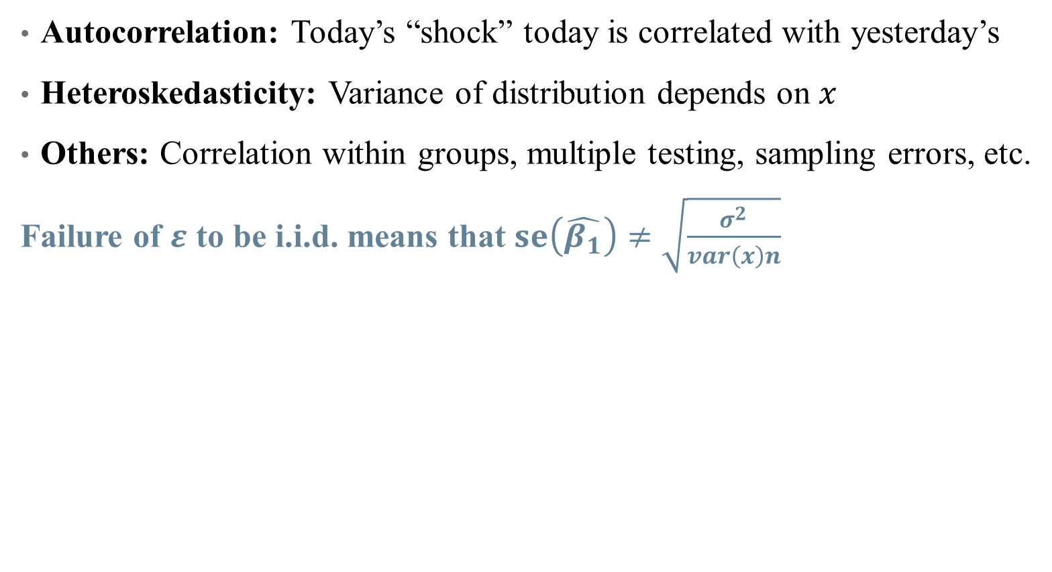
Are my error terms i.i.d.?
Autocorrelation: Today’s “shock” today is correlated with yesterday’s
Heteroskedasticity: Variance of distribution depends on $x$
Others: Correlation within groups, multiple testing, sampling errors, etc.
Failure of $ε$ to be i.i.d. means that $se\left(\hat{β_{1}}\right)≠\sqrt{\frac{σ^{2}}{var\left(x\right)n}}$
Notes:
Multiple testing – we’ve talked about this.

Slide 56
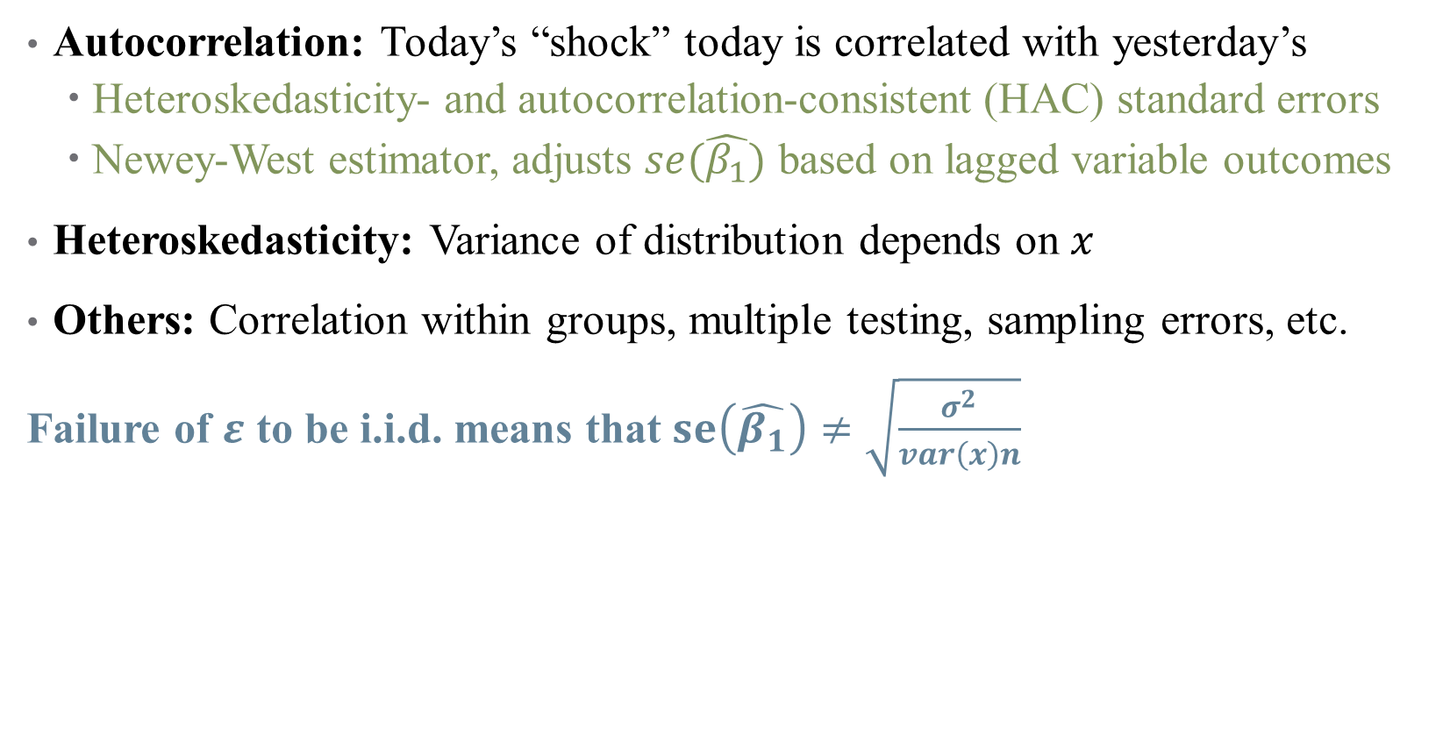
Are my error terms i.i.d.?
Autocorrelation: Today’s “shock” today is correlated with yesterday’s
Heteroskedasticity- and autocorrelation-consistent (HAC) standard errors
Newey-West estimator, adjusts $se(\hat{β_{1}})$ based on lagged variable outcomes
Heteroskedasticity: Variance of distribution depends on $x$
Others: Correlation within groups, multiple testing, sampling errors, etc.
Failure of $ε$ to be i.i.d. means that $se\left(\hat{β_{1}}\right)≠\sqrt{\frac{σ^{2}}{var\left(x\right)n}}$

Slide 57
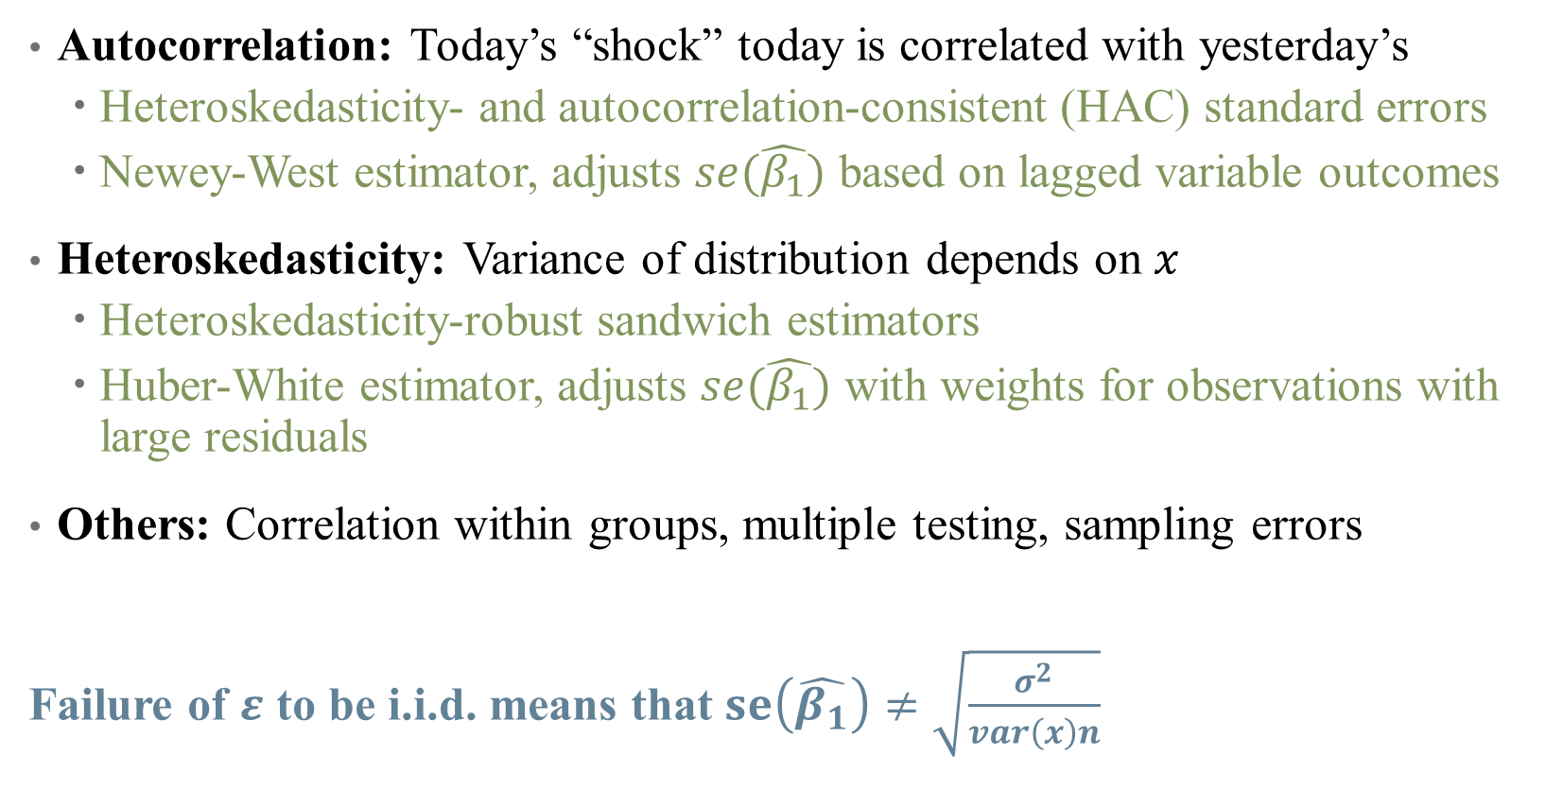
Are my error terms i.i.d.?
Autocorrelation: Today’s “shock” today is correlated with yesterday’s
Heteroskedasticity- and autocorrelation-consistent (HAC) standard errors
Newey-West estimator, adjusts $se(\hat{β_{1}})$ based on lagged variable outcomes
Heteroskedasticity: Variance of distribution depends on $x$
Heteroskedasticity-robust sandwich estimators
Huber-White estimator, adjusts $se(\hat{β_{1}})$ with weights for observations with large residuals
Others: Correlation within groups, multiple testing, sampling errors
Failure of $ε$ to be i.i.d. means that $se\left(\hat{β_{1}}\right)≠\sqrt{\frac{σ^{2}}{var\left(x\right)n}}$

Slide 58

Are my error terms i.i.d.?
Autocorrelation: Today’s “shock” today is correlated with yesterday’s
Heteroskedasticity- and autocorrelation-consistent (HAC) standard errors
Newey-West estimator, adjusts $se(\hat{β_{1}})$ based on lagged variable outcomes
Heteroskedasticity: Variance of distribution depends on $x$
Heteroskedasticity-robust sandwich estimators
Huber-White estimator, adjusts $se(\hat{β_{1}})$ with weights for observations with large residuals
Others: Correlation within groups, multiple testing, sampling errors
Clustered standard errors
Bootstrapped standard errors
Failure of $ε$ to be i.i.d. means that $se\left(\hat{β_{1}}\right)≠\sqrt{\frac{σ^{2}}{var\left(x\right)n}}$
Notes:
We’ll introduce robust errors – what we will usually use more is clustered robust.

Slide 59
Clustered Standard Errors
Errors might be correlated in a hierarchical structure
Example: effect of a health intervention across villages in rural area?
Different village structures mean people in same village have similar “shocks”
Errors might be correlated within villages
Notes:
Once again, we need to inflate our Ses to deal with this.

Slide 60

Clustered Standard Errors
Errors might be correlated in a hierarchical structure
Example: effect of a health intervention across villages in rural area?
Different village structures mean people in same village have similar “shocks”
Errors might be correlated within villages
There is a sandwich estimator that lets $X$ interact w/ other $Xs$ in the same group
Flexibly handles clustered standard errors!
But need to be careful how you choose the clusters
Good rule to remember: cluster at the level of the treatment
Notes:
Sandwich estimator is an econometrician’s fav thing.

Slide 61


Clustered Standard Errors
Notes:
When Should You Adjust Standard Errors for Clustering? Alberto Abadie, Susan Athey, Guido W. Imbens, and Jeffrey Wooldridge (metrics avengers)

Slide 62


Clustered Standard Errors
Notes:
How do you choose what to cluster?

Slide 63


Clustered Standard Errors
Notes:
Main takeaways – cluster at the highest level (e.g., state, not county), but carefully consider when you should cluster (a Type II error is just as bad as a Type I). One rule when you should cluster: fixed effects + treatment heterogeneity.

Slide 64

Bootstrapped Standard Errors
One of the most powerful tools in statistics!
If we want to learn something about the sampling distribution, why not just take a bunch of samples and see how our estimates vary?
These are very useful for estimating $se(\hat{β_{1}})$ in unusual cases!
A couple caveats
Needs large sample sizes to work well
Can’t completely handle autocorrelation

Slide 65
Bootstrapped Standard Errors
One of the most powerful tools in statistics!
Start with a data set with observations.
Randomly sample observations from that data set, allowing the same observation to be drawn more than once. This is a “bootstrap sample.”
Estimate our statistic of interest using the bootstrap sample.
Repeat steps 1-3 a whole bunch of times.
Look at the distribution of estimates from across all the times we repeated steps 1-3. The standard deviation of that distribution is the standard error of the estimate. The 2.5th and 97.5th percentiles show the 95% confidence interval, and so on.

Slide 66
Notes on Causality and Bias
Notes:
Quick example on logs: suppose we do
y=bx, where b=5. Then how do we interpret?
Y=b*log(x) where b = 5. Then a 1% increase in x corresponds to a 5*.01 = 0.05 unit increase in y
Log(y) = b*x where b = 5. Then a 1 unit increase in x corresponds to a 500% (5-fold increase) in y
Log(y) = b*log(x). Then a 1% increase in x corresponds to a 0.05 increase in log(y), so roughly a 5% increase in y.

Slide 67
Interpreting your results causally (One more time)
Remember that causality is hard!
Even after specifying your model, other things could go wrong:
Omitted Variables: missing data can bias your estimates
Measurement Error: mismeasured data can bias your estimates
Collinearity: correlation between variables can limit inferences
Notes:
We’re gonna touch on more threats to internal validity now.

Slide 68


Omitted Variables
Maybe you didn’t have data on a specific variable $z$
But if $Corr\left(x,z\right)≠0$, then omitting $z$ means $E\left(ε|x\right)≠0$
X
D
$$Y$$
R
Notes:
Leaving a back door open is a big problem in design-based inference. We’ve talked about this a lot, let’s look at some math real quick.

Slide 69


Omitted Variables
Maybe you didn’t have data on a specific variable $z$
But if $Corr\left(x,z\right)≠0$, then omitting $z$ means $E\left(ε|x\right)≠0$
This leads to bias in your estimates:
$$bias\left(\hat{β_{1}}\right)=𝔼\left[\hat{β_{1}}\right]−β_{1}$$
$$=Corr\left(x,z\right)\frac{σ_{ε}}{σ_{x}}$$

Slide 70

Measurement Error
Imprecision in your data also leads to biased estimates
Suppose that we don’t observe $x$, but rather $\tilde{x}=x+ζ$, where $ζ∼N(0,1)$
In this (classical) sense, this kind of error attenuates a regression coefficient
Notes:
Attenuation is a common refrain in published papers, but measurement error is more complicated than that!

Slide 71

Measurement Error
Imprecision in your data also leads to biased estimates
Suppose that we don’t observe $x$, but rather $\tilde{x}=x+ζ$, where $ζ∼N(0,1)$
In this (classical) sense, this kind of error attenuates a regression coefficient
However, nonclassical measurement error can lead to all kinds of problems
Examples of non-classical measurement error:
X is binary, so $Corr\left(ζ, x\right)≠0$by definition
Classification error (binary treatment variable)
Underreporting (income, crime, etc.)
Selection and open back doors!

Slide 72

Classical Measurement Error
Notes:
But when is it really classical?

Slide 73

Non-Classical Measurement Error: Examples
Notes:
Measurement error can be the result of an open back door, or selection – what health examples are there?

Slide 74

Non-Classical Measurement Error: Examples
Effect of hospital quality on patient outcomes $⇒$
What about the hospitals that attract the riskiest patients?
Which types of patients end up on ventilation?
Which types of patient-hospital pairs may have the most likelihood of “mismeasuring” quality?
Notes:
A whole literature on risk adjustment exists to (try to) solve this issue!

Slide 75

Collinearity and Causality
Some (explanatory) variables are highly correlated, complicating inference
Notes:
If I include age and height in a regression to close back doors, how do I know what is explained by age and what is explained by height? Here, this might not matter (we just care about “growth” as the causal pathway) but what if we could consider a policy that would randomly make people taller. Would that help health? Shrugh

Slide 76

Collinearity and Causality
Some (explanatory) variables are highly correlated, complicating inference
Inclusion of irrelevant variables tends to inflate the SEs for other estimates
What’s more, if variables are too highly correlated, their effects are indistinguishable
We’ve already run into the problem of perfect collinearity (where?)
A much harder problem is near-collinearity, where $\left|ρ\left(x_{1},x_{2}\right)\right|≈1$
This is especially problematic when we care about $β_{1}$or $β_{2}$, but not both
Notes:
Where have we seen perfect collinearity? Dummy variable trap?

Slide 77

Collinearity and Causality
Some (explanatory) variables are highly correlated, complicating inference
Inclusion of irrelevant variables tends to inflate the SEs for other estimates
What’s more, if variables are too highly correlated, their effects are indistinguishable
We’ve already run into the problem of perfect collinearity
A much harder problem is near-collinearity, where $\left|ρ\left(x_{1},x_{2}\right)\right|≈1$
This is especially problematic when we care about $β_{1}$or $β_{2}$, but not both
How to diagnose this?
Look at correlation matrix of independent variables
Think about which correlations mess with your DAG
Notes:
Think about how much it really matters – collinearity is a problem if it messes with the causal parameter of interest, but doesn’t matter if age and height are both controls.

